Slide 1


HOME | Creations & Development
What it should feel like
Notes:
Welcome, This is the General introductory presentation to Home Creations & development company.

Slide 2
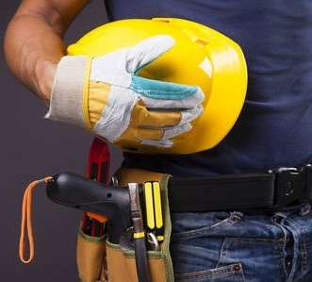
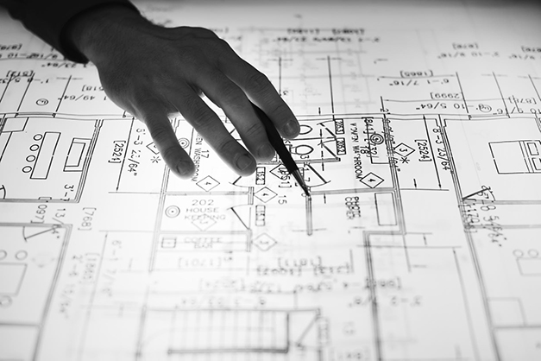
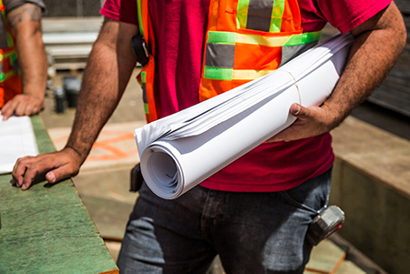

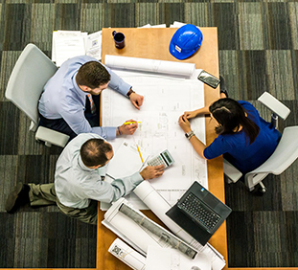

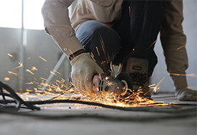
WHO WE ARE
Founded on the idea that the place we call Home is not just a building… But It is
every structure that
surrounds us…
Notes:
Home | Creations & Development was founded on the idea that the place we call Home is not just a building… We believe that home is wherever we are free to imagine, think and create. In other words, we seek to design and build spaces where people are best set up to thrive.

Slide 3
WHAT WE’RE MADE OF
4 Head Departments:
General Supplies
Facility Management
Construction
Design
A unique synthesis of 4 service departments makes HOME | C&D literally a one-stop-shop for all construction needs.
Notes:
From design to construction, general supplies to facilities management, HOME | C&D is the one-stop-shop for all your creations and development needs. Our family of pioneer designers, engineers, managers, and technicians, along with a broad network of contractors, do the heavy lifting so you don't have to.

Slide 4

VISION
Smart Integration
Competitive Pricing
Customized Service
Satisfying Careers
…of fast, high quality construction, innovative design and forward-thinking management solutions in Egypt and abroad.
Passion drives us to be the leading provider…
Notes:
Passion drives us to be the leading provider of fast, high quality construction, innovative design and forward-thinking management solutions in Egypt and abroad.

Slide 5
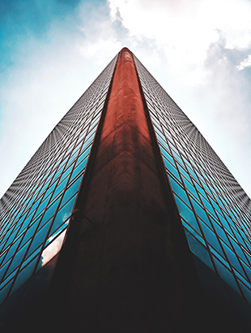
MISSION
Exceed client expectations
Uphold a reputation for excellence
Provide an open, ethical & empowering work environment
Demonstrate respect & fairness in all relationships
Build & maintain long-lasting stakeholder partnerships

Slide 6
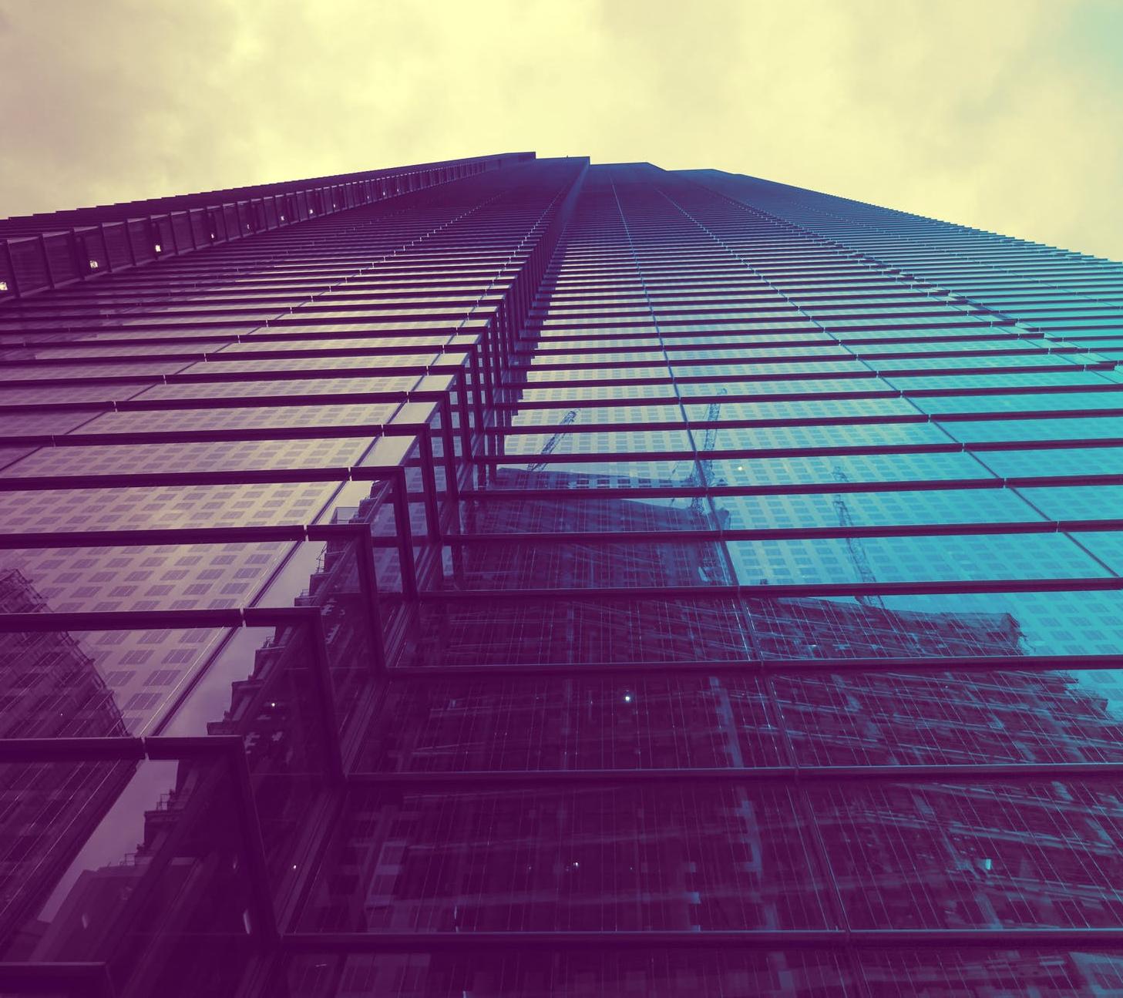
VALUES
Passion
Safety & Health
Ethics
Integrity
People
Professional
Sustainable
Quality
Client-Oriented
Innovation
Notes:
Our values are the foundation for all our business activities, and are the pillars of our success. Our internal motivation comes from our passion for integrity, a hard work ethic, and the people on our team. Our work is defined by professionalism, the sustainability and quality of our end results. We approach every job with a client-oriented process that focuses on innovation, safety and health.

Slide 7

PROMISE
We deliver:
​Quality
Cost-Efficiency
Dependability
Unbeatable Prices
Innovation
Results
Notes:
No matter the project, we promise to deliver results of the highest quality, cost-efficient designs, depend on us to execute our job with unbeatable prices, and innovative solutions. In other words, we promise results.

Slide 8
TARGETED SERVICES
Facility Management
Construction
General Supplies
Engineering Services
Notes:
We provide targeted services for all creations and development projects. Beginning with smart engineering services and designs, we provide every project with detailed planning for efficient execution. Then our general supplies department goes the extra mile to get you the materials you need to complete the project. After that, our construction teams execute every aspect of your project down to the tiniest detail. Once we have fulfilled all of your creation and construction needs, our facilities management department ensures that your buildings continue to operate at optimum while you save money on supplies, construction and maintenance expenses.
Experienced in building high-performance buildings, we safeguard your investment and guarantee efficiency and cost-effectiveness for a more profitable business.

Slide 9
Engineering Services
We Produce
Project Types
Methods
Studies
Calculation Sheets
Architectural Designs
Equipment Selection
Shop Drawings
Coordination Drawings
As-built Drawings
Residential
Public Infrastructure
Urban Development
Power Projects
Custom Projects
Design sciences used to research and implement up-to-date execution techniques and technologies.
Notes:
We perform studies, engineering calculations, designs, equipment selection, shop drawings, coordination drawings and as-built drawings for projects ranging in complexity and magnitude from a single-family house to infrastructure, urban development projects and power projects.
We provide comprehensive and outstanding designs that strive to be innovative, technically sound, environmentally friendly, low cost, and delivered on time.
We Use the latest design technologies and sciences, and we research and implement the latest execution techniques and technologies.
We believe that our success is presented by how our designs are perceived by the user, starting with the owner, to the contractor, and most importantly the end user

Slide 10
Engineering Services
Hydro
Hydrologic studies
Hydrogeologic studies
Interior Design
Pressurized Networks design
Unpressurized Networks design
Highway & freeway design
Architecture
Exterior & Landscape design
Structural Design
MEP
Concrete structures
Steel Structures
Infrastructure
E.S. Department
Notes:
Our Engineering Service Department produces Hydro studies, Infrastructure Designs, Architectural Designs, Structural Designs and even complete Mechanical, Electrical and Plumbing designs.

Slide 11
GENERAL SUPPLIES
Construction Supplies
Functionality Supplies
FM Supplies
Notes:
The HOME | C&D General Supplies department runs the gamut on essential supplies; we provide office soft supplies, supplies for maintenance and the functionality of all physical resources, as well as mega projects’ construction needs.
Competitive prices on the most technically sound supplies for virtually every job. Our experienced supply team of engineers is on standby to provide the most accurate and quick turn around on every order.

Slide 12
CONSTRUCTION
Renovation & Remodeling
Design-build
General Contracting
Project Management
Pre-construction
Notes:
Meeting the needs of businesses for any construction project, from large, equipment-heavy warehouses to intimate outlets and dazzling showrooms. We leave nothing to be desired in our administrative and residential projects.
We challenge you to find any aspect of construction we can’t handle!

Slide 13
FACILITY MANAGEMENT
Structural
Architectural
Electrical
Mechanical
Safety & Security
Soft Facilities Management
Notes:
Our facilities management department ensures that all facilities receive minute to minute monitoring, the fastest response time, regular, systematic assessments, and detailed optimization reports to improve safety, security, functionality and aesthetics of all physical resources. We guarantee swift execution on repairs and performance upgrades, and we provide the kind of attention to detail that ensures all projects are completed on time and within budget.

Slide 14
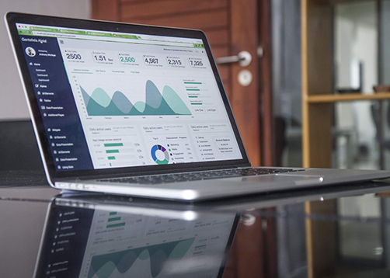
TIME IS MONEY $$$
Let HOME | C&D get started improving your business NOW, so you see results TODAY!
Notes:
Let HOME | C&D help you manage your business’ risks, cut unnecessary costs and ensure long-term success of your projects. Reach out to our friendly customer service team to get started on your creations and development projects today by clicking on the links in the caption.

