Slide 1


HOME | Creations & Development
Engineering Service provider of choice
Notes:
Welcome, This is the introductory presentation to Home Creations & development Engineering Service Department. If you haven’t already downloaded the general introductory presentation to our company, please check it out.

Slide 2
Engineering Services
We Produce
Project Types
Methods
Studies
Engineering Calculation Sheets
Architectural Designs
Equipment Selection
Shop Drawings
Coordination Drawings
As-built Drawings
Residential
Public Infrastructure
Urban Development
Power Projects
Custom Projects
Design sciences used to research and implement up-to-date execution techniques and technologies.
Notes:
We perform studies, engineering calculations, designs, equipment selection, shop drawings, coordination drawings and as-built drawings for projects ranging in complexity and magnitude from a single-family house to infrastructure, urban development projects and power projects.
We provide comprehensive and outstanding designs that strive to be innovative, technically sound, environmentally friendly, low cost, and delivered on time.
We Use the latest design technologies and sciences, and we research and implement the latest execution techniques and technologies.
We believe that our success is presented by how our designs are perceived by the user, starting with the owner, to the contractor, and most importantly the end user

Slide 3
ENGINEERING SERVICES
Hydro
Hydrologic studies
Hydrogeologic studies
Interior Design
Pressurized Networks design
Unpressurized Networks design
Highway & freeway design
Architecture
Exterior & Landscape design
Structural Design
MEP
Concrete structures
Steel Structures
Infrastructure
E.S. Department
Notes:
Our Engineering Service Department produces Hydro studies, Infrastructure Designs, Architectural Designs, Structural Designs and even complete Mechanical, Electrical and Plumbing designs.

Slide 4
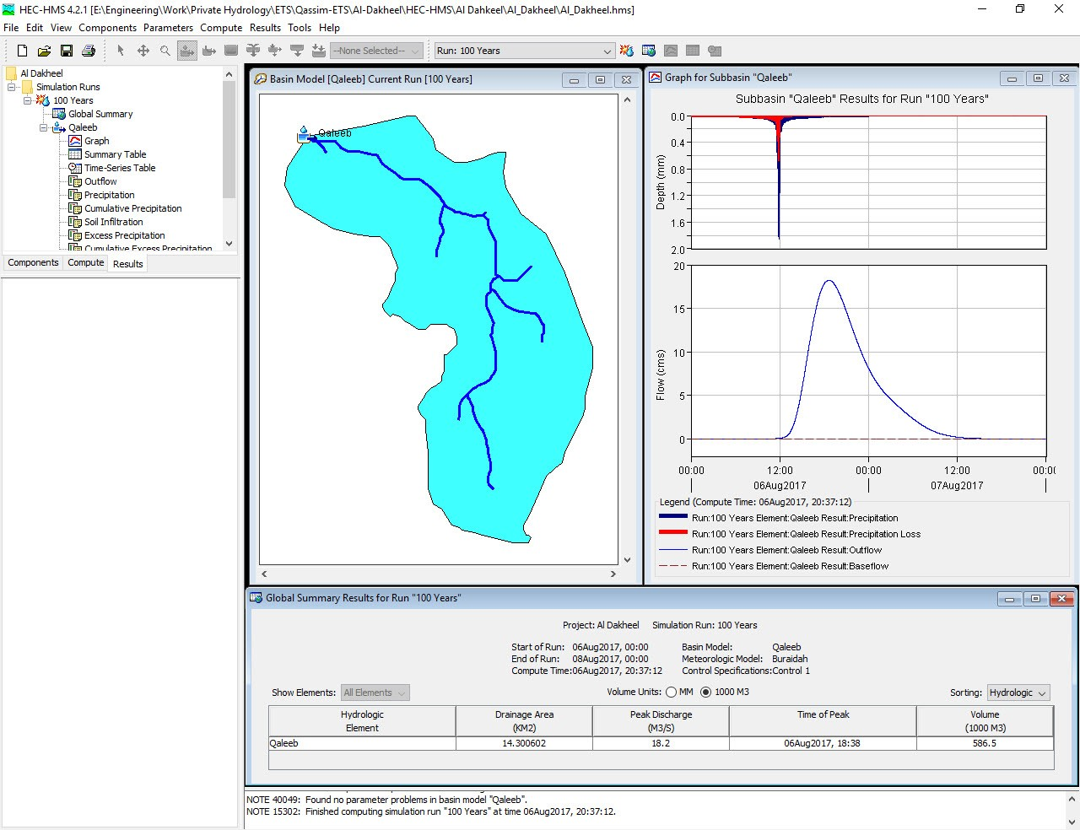
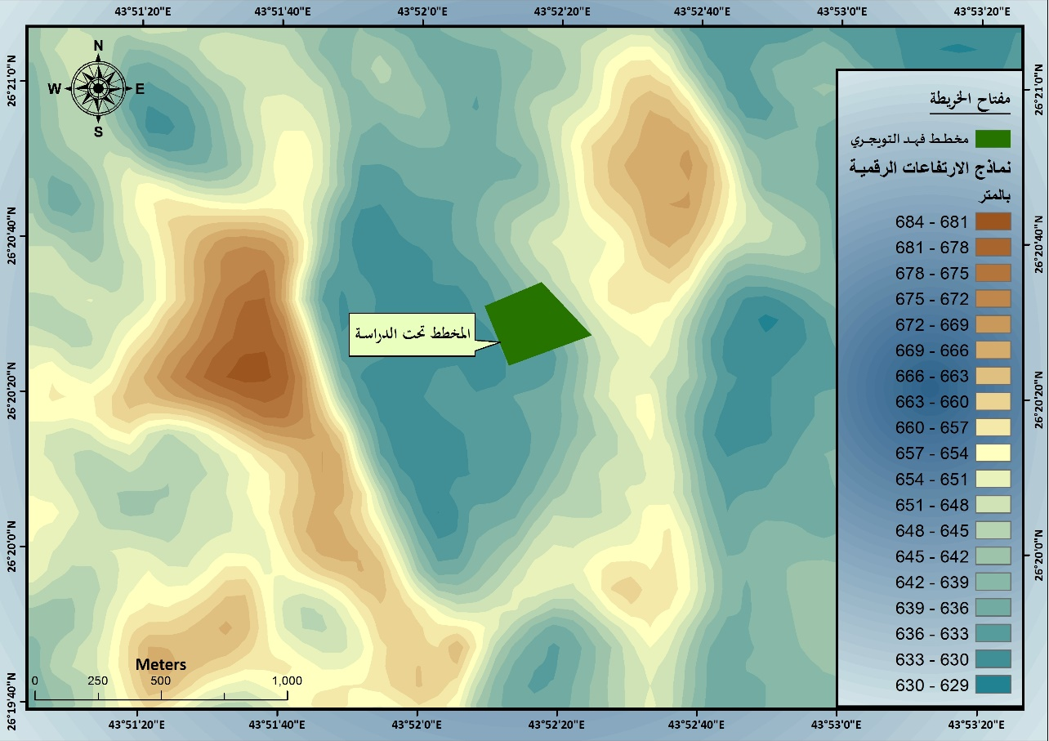
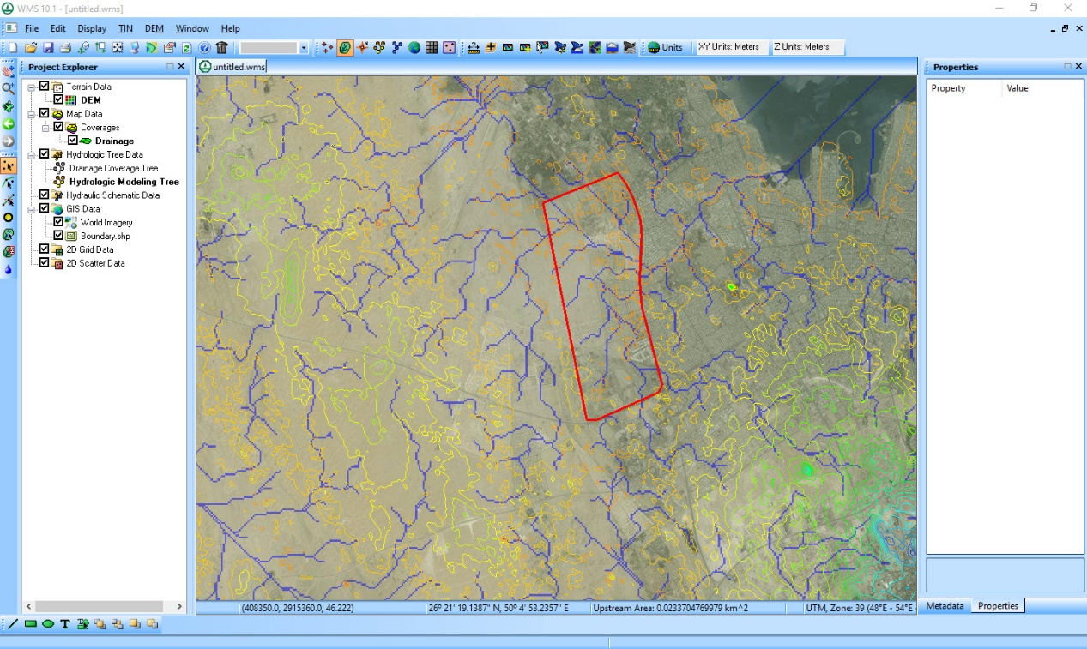
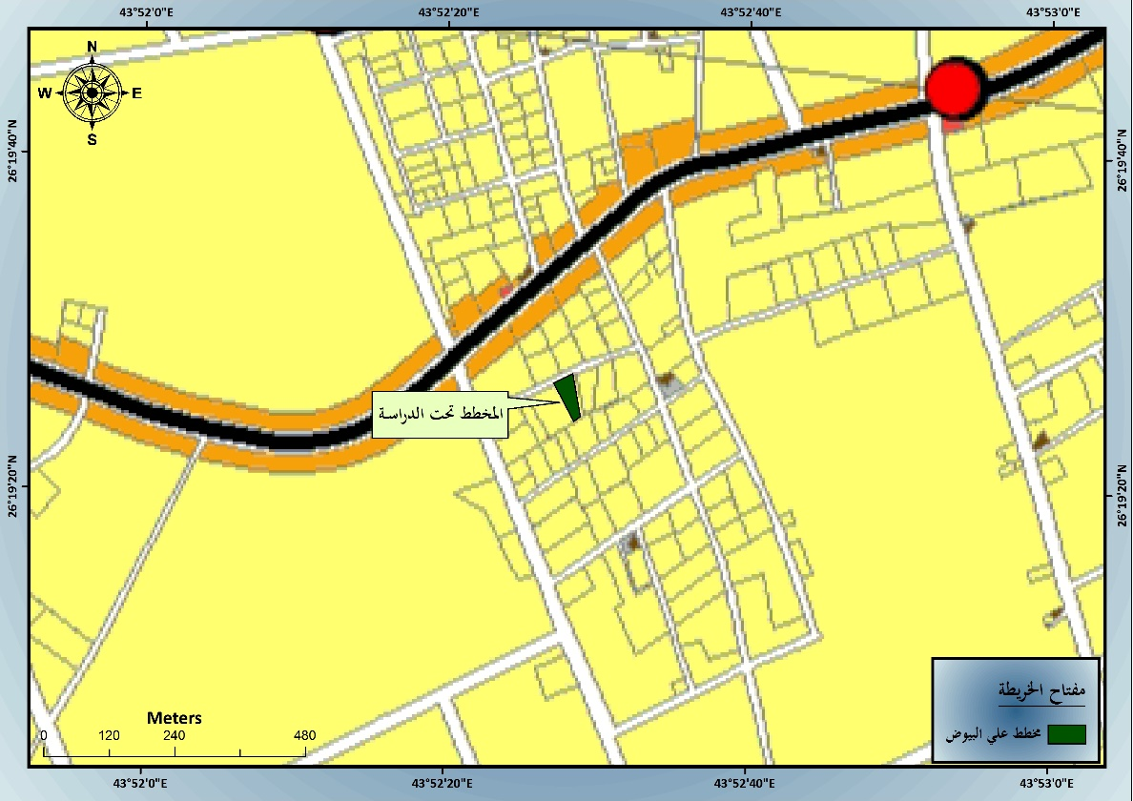
HYDROLOGIC STUDIES
Methodology
  Topographic Study & Survey Works
  Geological Study & Land Use Maps
  Metrological Study & Rainfall Data Analysis
  Morphological Study
  Hydrological Modeling
Notes:
Floods and deluges are among the most significant threats facing urban expansion. The risks, impact and preventative measures for protection of people and property should be carefully calculated and analyzed through a full hydrologic study. hydrologic studies are critical before commencing urban planning or establishing any central or regional road networks.
Our method for producing a hydrologic study includes…..

Slide 5
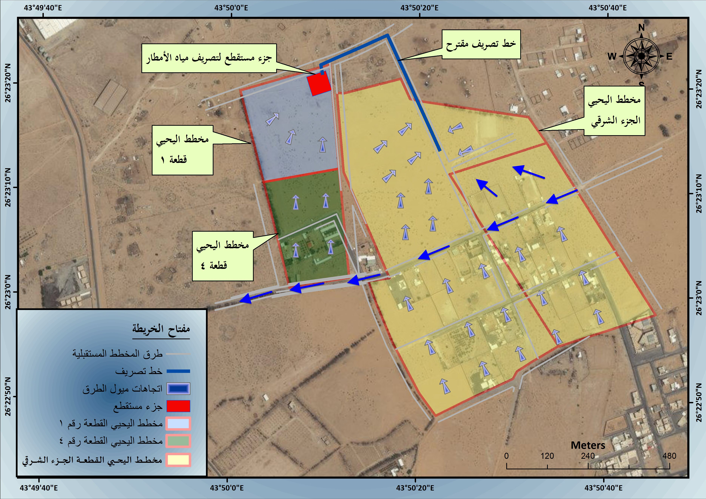
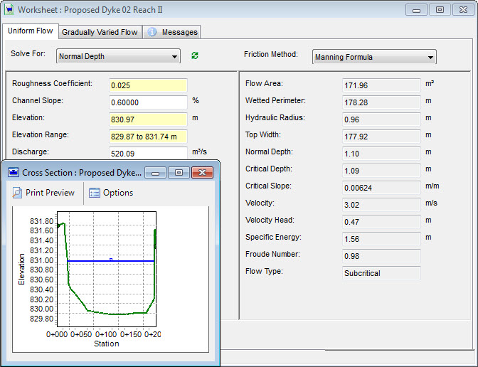
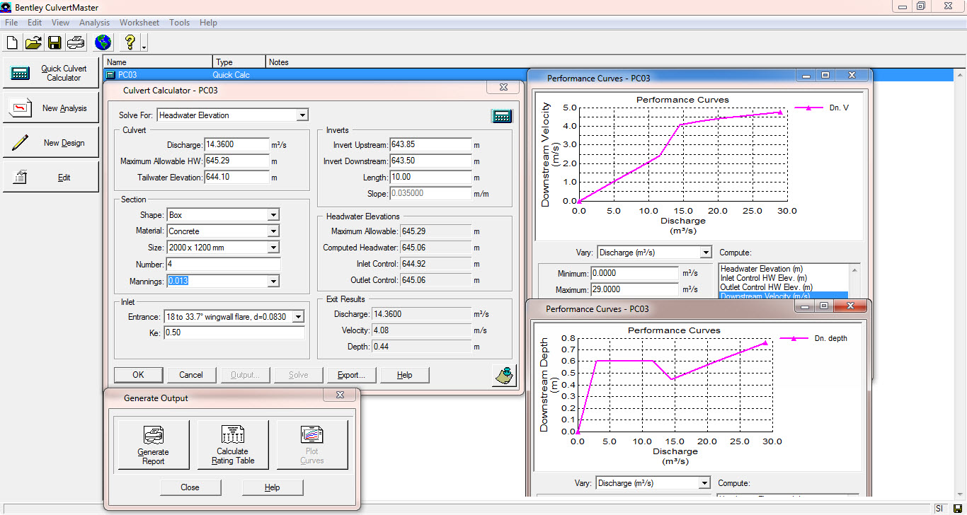
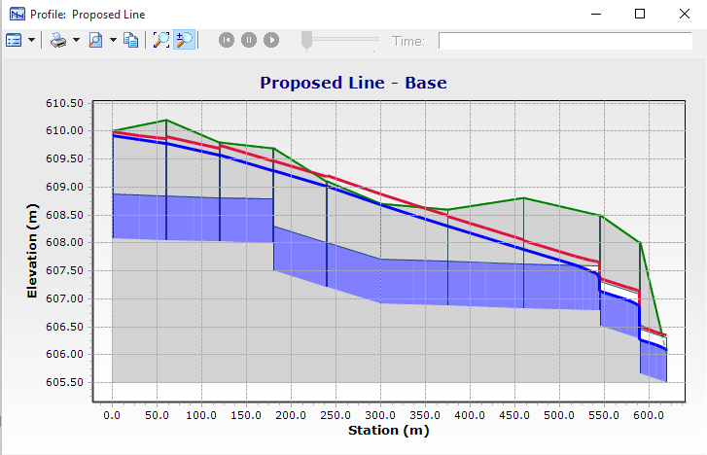
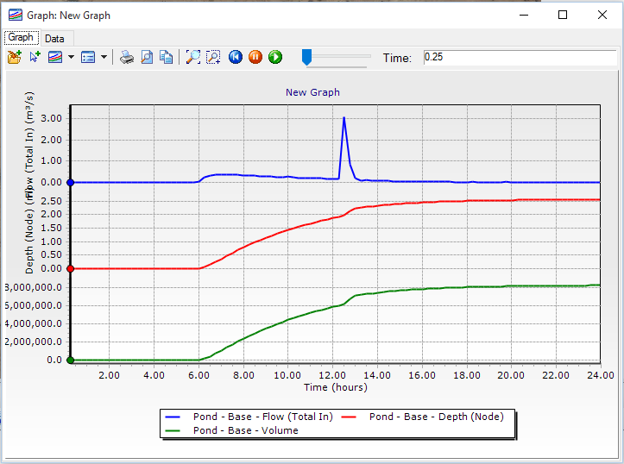
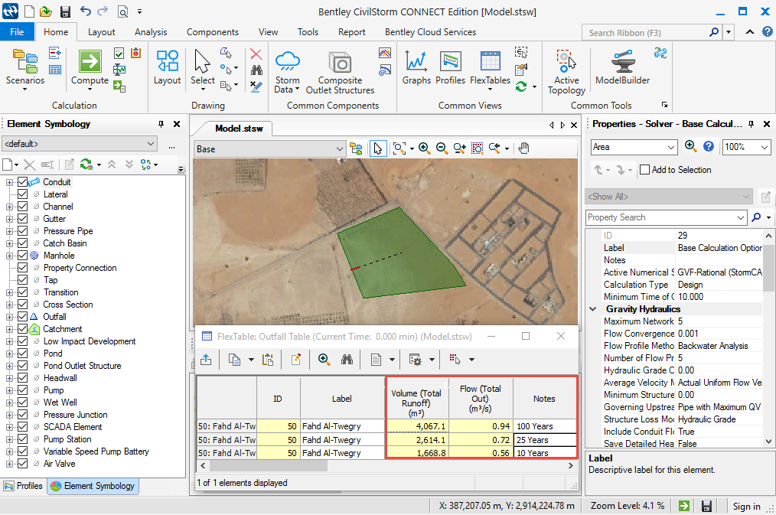
HYDROLOGIC STUDIES
  Alternative Solutions
  Models
  Recommendations
Notes:
After determining the quantities of expected flow rate on the scheme we provide:
1 - Recommendations for alternatives to the proposed solutions to protect the desired scheme from flood hazards and rainwater drainage;
2 - Production of hydraulic models of the proposed solutions
3 - Production of hydraulic modeling of the proposed storm drainage network

Slide 6
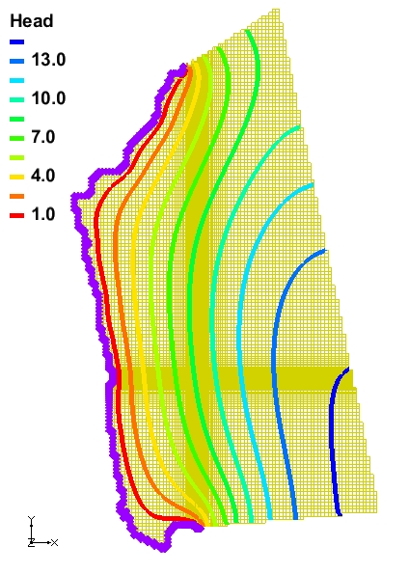
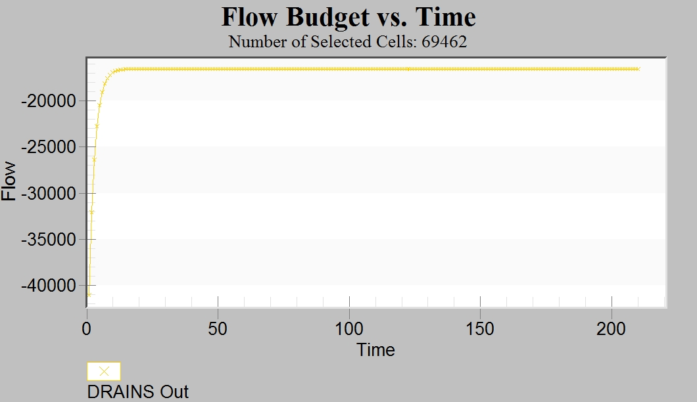
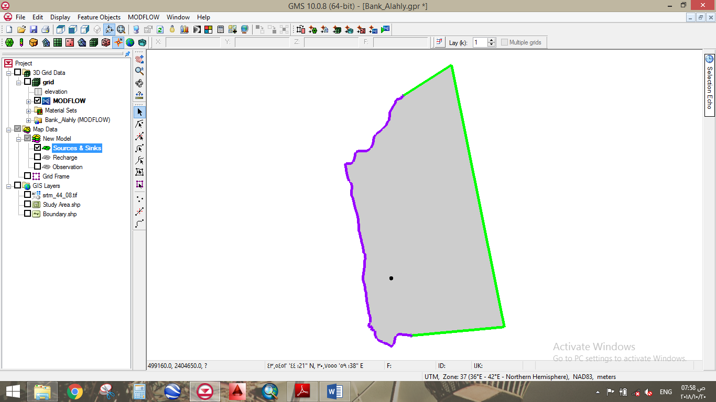
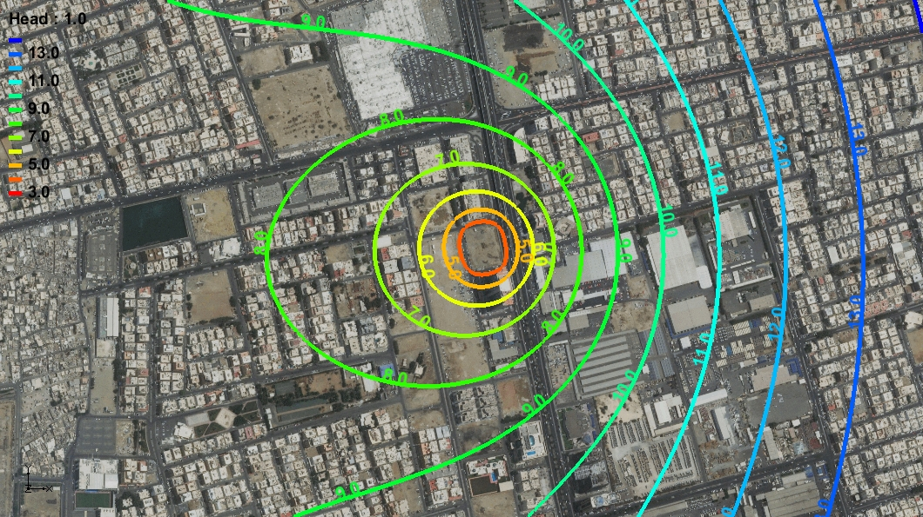
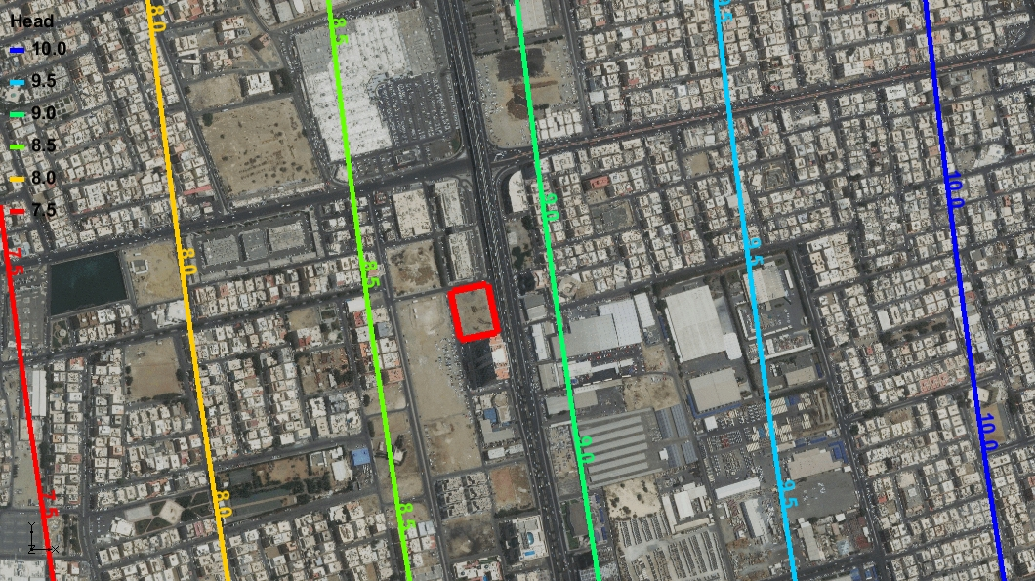
HYDROGEOLOGIC STUDIES
Methodology
  Identify & analyze topography
  Identify & analyze project area geology
  Produce conceptual model
  Produce groundwater numerical model
  Adjust calibration
  Represent groundwater movement resulting from implementation conditions.
Notes:
Hydrogeologic studies deal with the distribution and movement of groundwater in the soil and rocks of the Earth's crust (commonly in aquifers). Shallow groundwater and aquifers threaten urban expansion. The risks, impact and preventative measures for protection of people and property should be carefully calculated and analyzed through a full hydrogeologic study. hydrogeologic studies are critical before commencing construction projects.
Our method for producing a hydrogeologic study includes…..

Slide 7
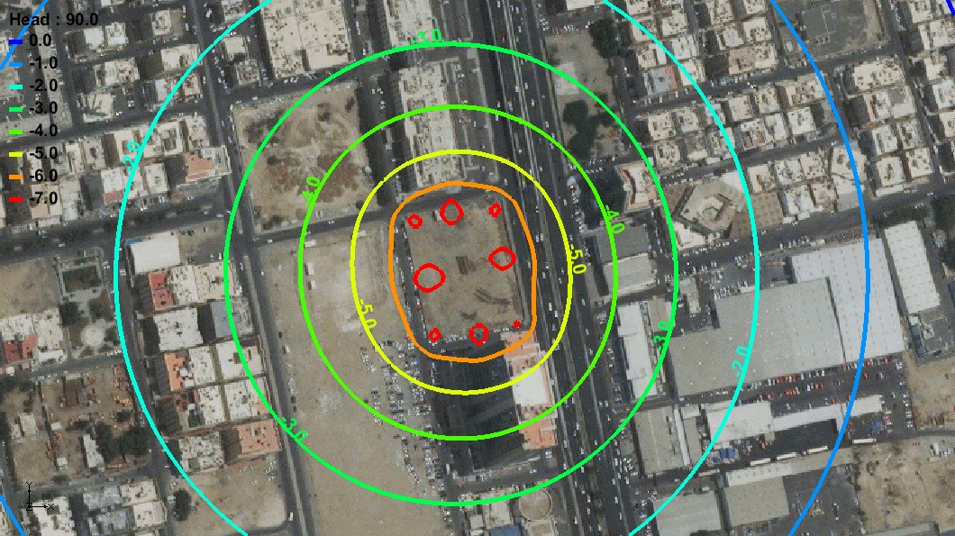
HYDROGEOLOGIC STUDIES
Results
  Engineering solutions design
Notes:
Depending on the results of the Hydrogeologic study, we provide numerical and operation models to predict the amount and rate of water that will be displaced by the project drilling requirements. Our engineering solutions facilitate efficient water extraction and ensure project safety.

Slide 8
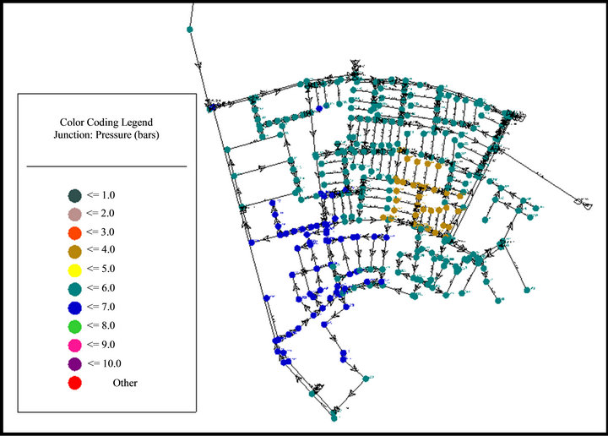
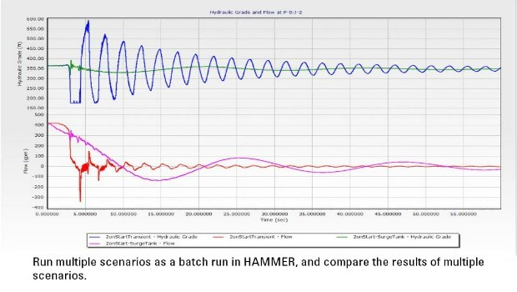
PRESSURIZED NETWORKS DESIGN
Pressurized water systems:
  Determine daily water consumption
  Specify design techniques
  Design network according to approved codes
  Produce calculation sheets & drawings
Notes:
Using the expected population of the design year we calculate the daily water consumption.
Then we study the terrestrial topography & water resources in order to specify our design techniques for the network.
Next we design our network according to the approved codes, ensuring that the designs accommodate the water velocity & pressure limits, and determining the locations of valves for washout, air release & shutoff, etc.
Finally, we produce full calculation sheets & design drawings of the network.

Slide 9
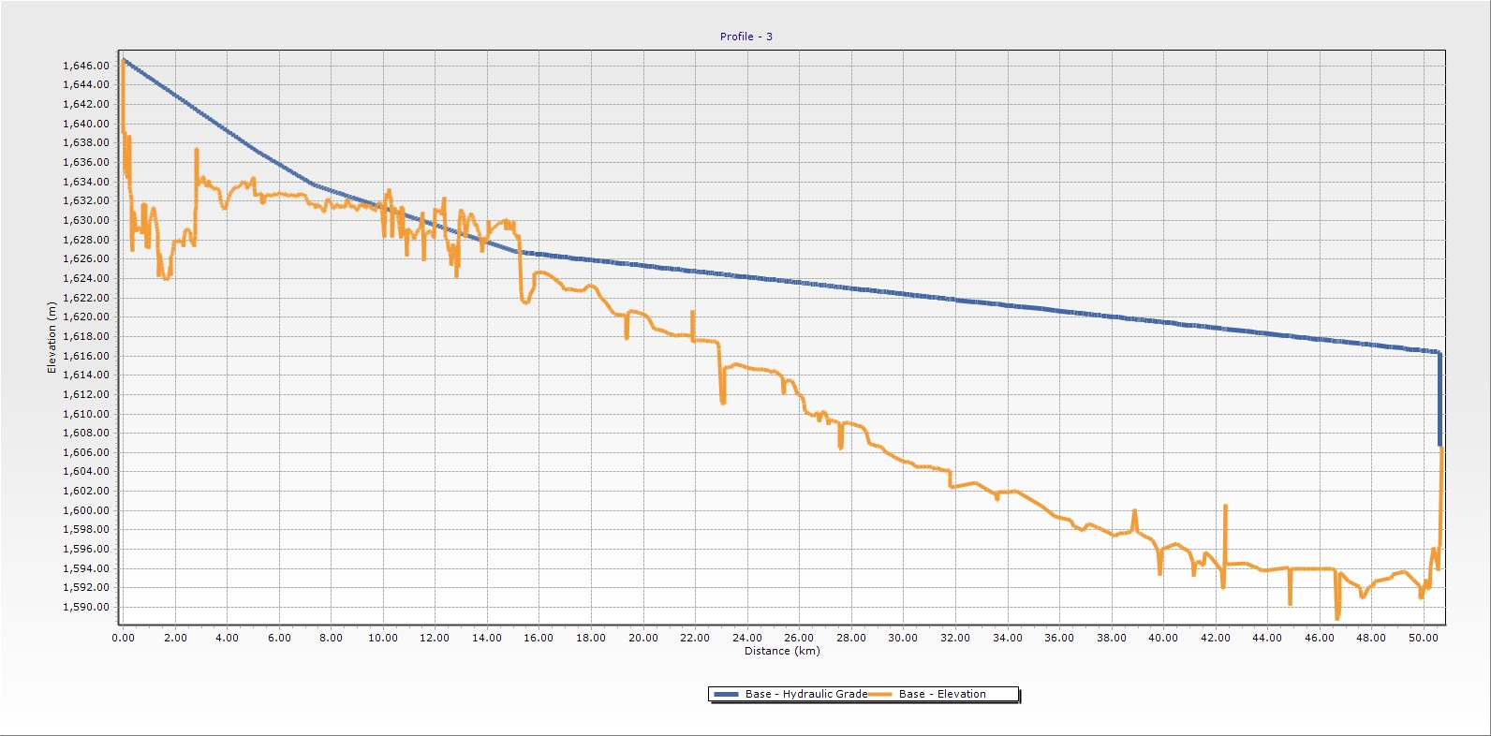
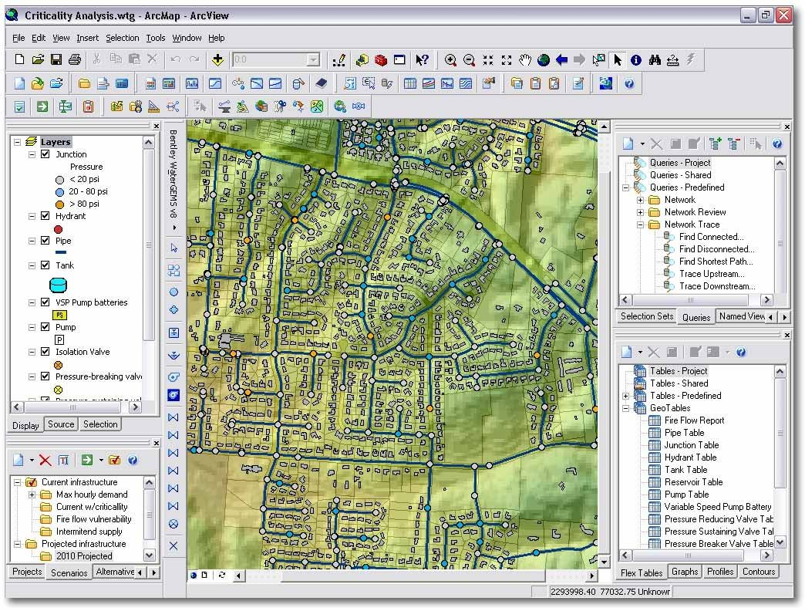
PRESSURIZED NETWORKS DESIGN
Pressurized Irrigation Systems:
  Estimate Design Water Requirement
  Determine Design Technique Of Network
  Design Network With Approved Codes
  Produce Calculation Sheets & Drawings
Notes:
Pressurized irrigation systems:
Depending on the type of crops, we estimate the design water requirement
Then We Study the terrestrial topography and water resources in order to determine the design technique of the network
Next we design our network according to the approved codes, ensuring that the designs accommodate the water velocity & pressure limits, and determining the locations of valves for washout, air release & shutoff, etc.
Finally, we produce full calculation sheets & design drawings of the network.

Slide 10
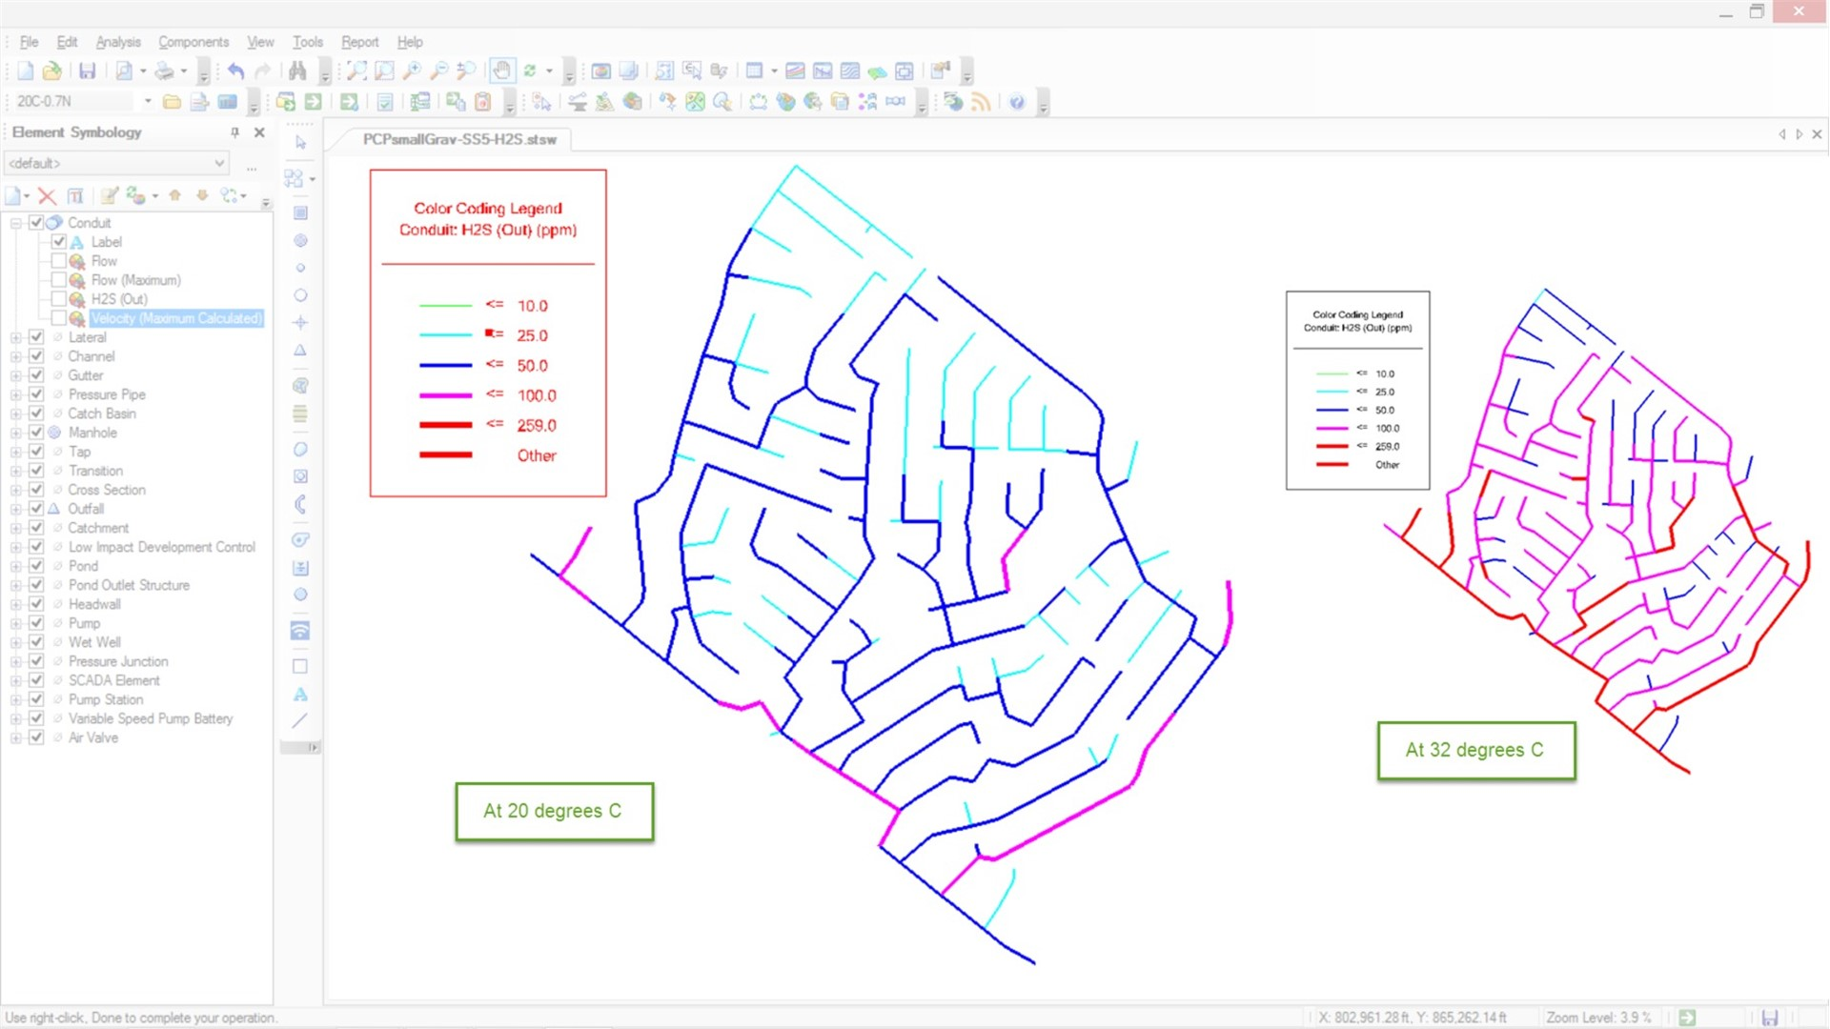
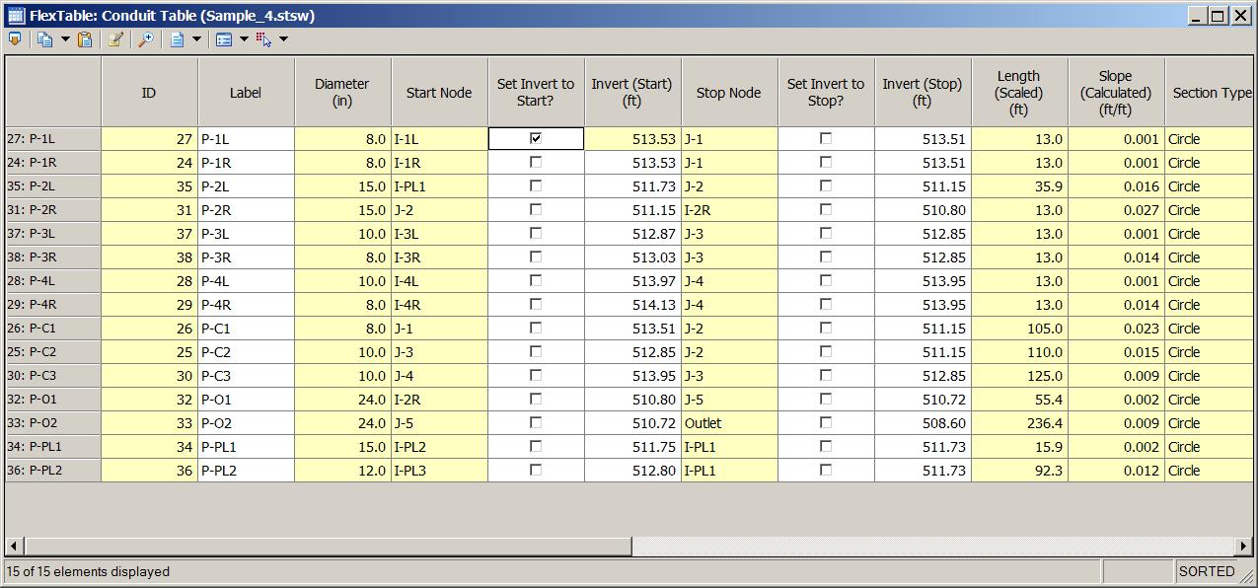
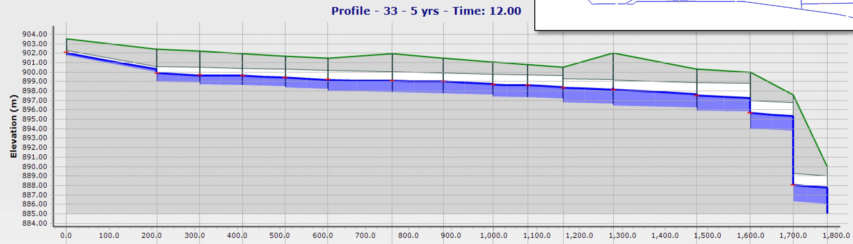
UNPRESSURIZED NETWORK DESIGN
Unpressurized Sewage:
  Determine Daily Water Consumption
  Determine The Outlet Of The Network
  Design Network With Approved Codes
  Produce Calculation Sheets & Drawings
Notes:
Unpressurized Sewage:
Using the expected population of design year, we determine the daily water consumption
Then we study the topography & the locations of the treatment plants or main network in order to determine the outlet of the new network.
Next we design our network according to the approved codes, ensuring that the designs accommodate the water velocity & slopes limits, and determining the locations of valves for washout, air release & shutoff, etc.
Finally, we produce full calculation sheets & design drawings of the network.

Slide 11
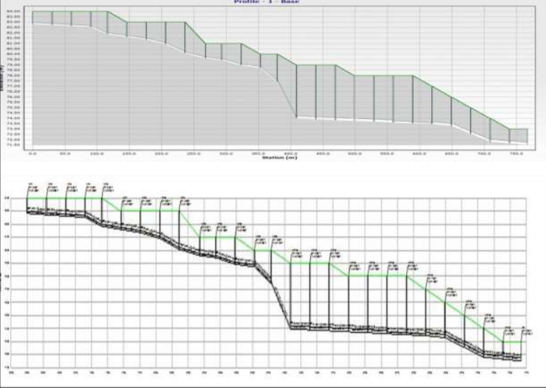
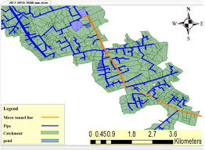
Unpressurized Network Design
Unpressurized Storm Drainage Systems:
  Calculate Expected Rainfall Depths For Design Return Period
  Determine Placement Of Network Outlet
  Design Network With Approved Codes
  Produce Calculation Sheets & Drawings
Notes:
Unpressurized Storm Drainage Systems:
We first calculate the expected rainfall depths ​​of study area for the design return period.
Then we complete a full study the topography, wadis, storage ponds or existing main network to determine the network outlet
Next we design our network according to the approved codes, ensuring that the designs accommodate the water velocity & slopes limits, and determining the locations of valves for washout, air release & shutoff, etc.
Finally, we produce full calculation sheets & design drawings of the network.

Slide 12
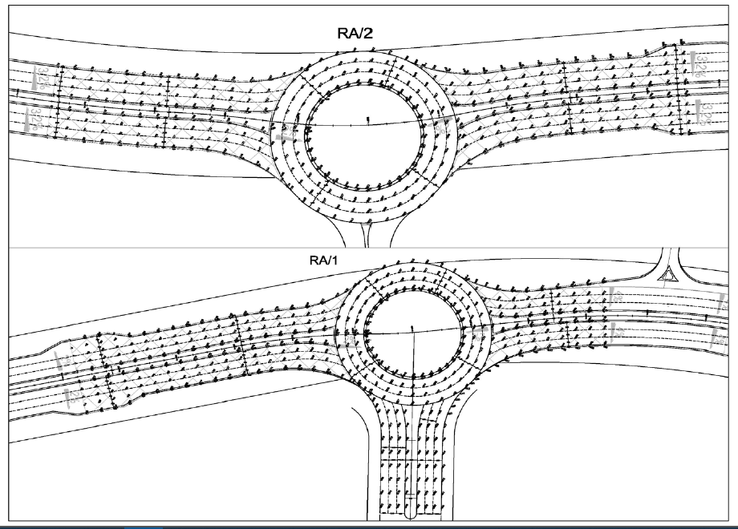
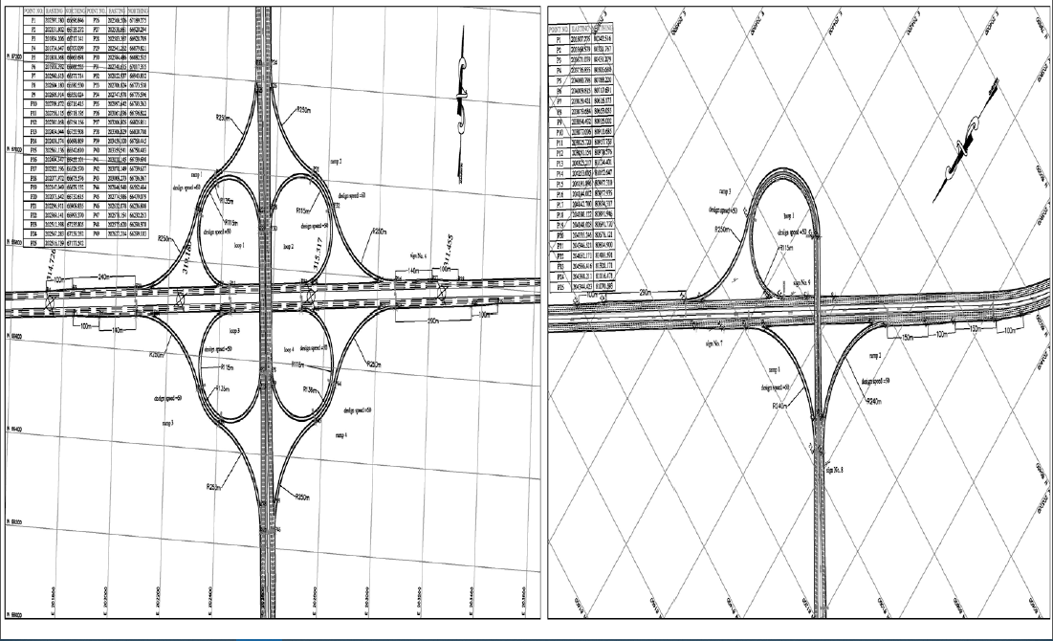
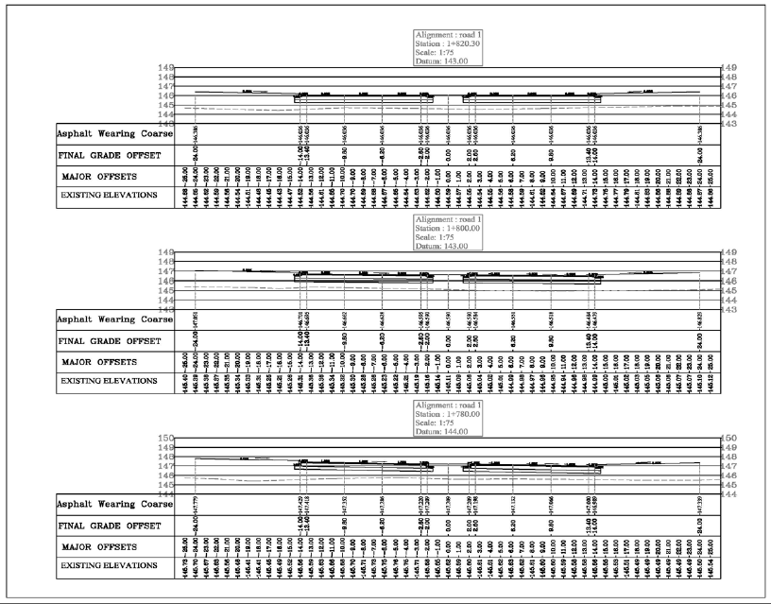
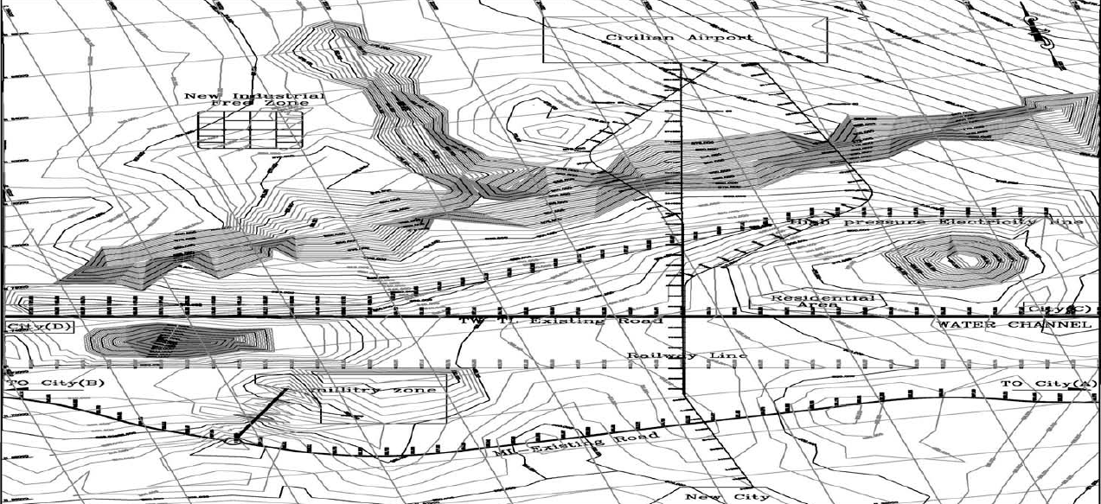
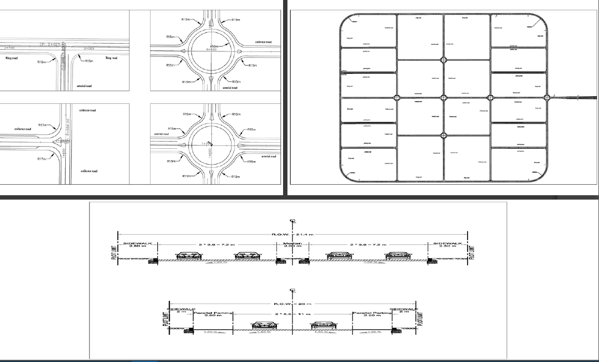
HIGHWAY & FREEWAY DESIGN
Identify Paths
Finalize Geometric Designs
Produce Shop Drawings
Produce Spot Elevation And Cross Section Details
Produce Cut & Fill Quantities & Plans
Notes:
We first study the topography to identify network paths that ensure minimum costs & travel time.
Then we finalize geometric designs to satisfy the projections of the traffic studies and safety limits and regulations.
Next we produce the final geometric design for all interchanges, intersections, shop drawings, spot elevation and cross section details.
Finally we Produce cut & fill quantities and plans.

Slide 13
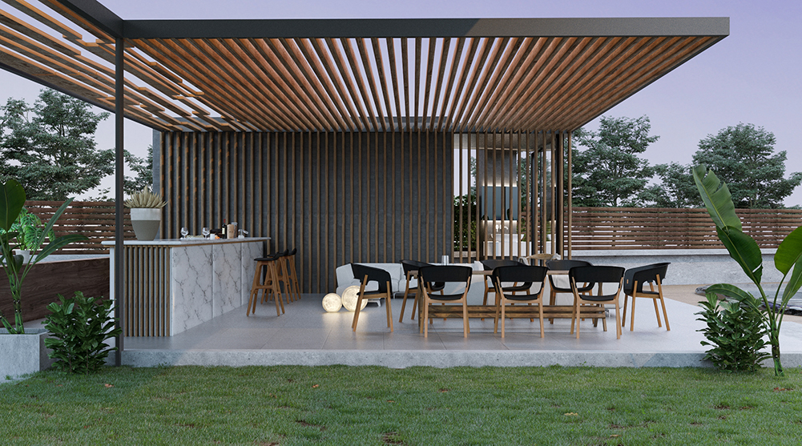
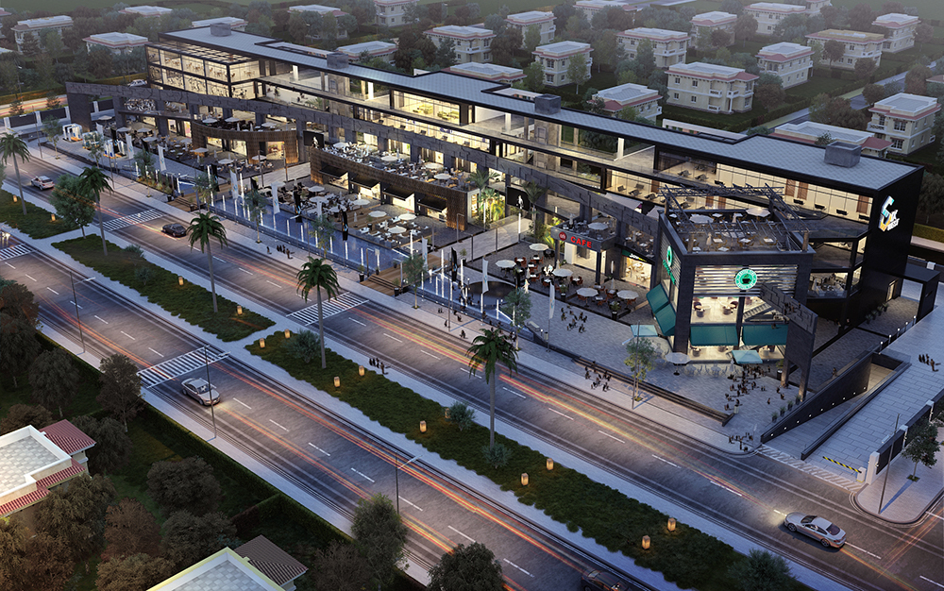
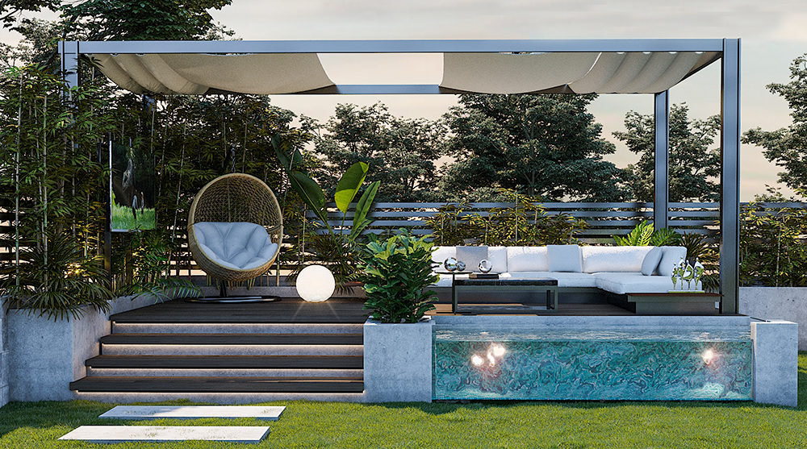
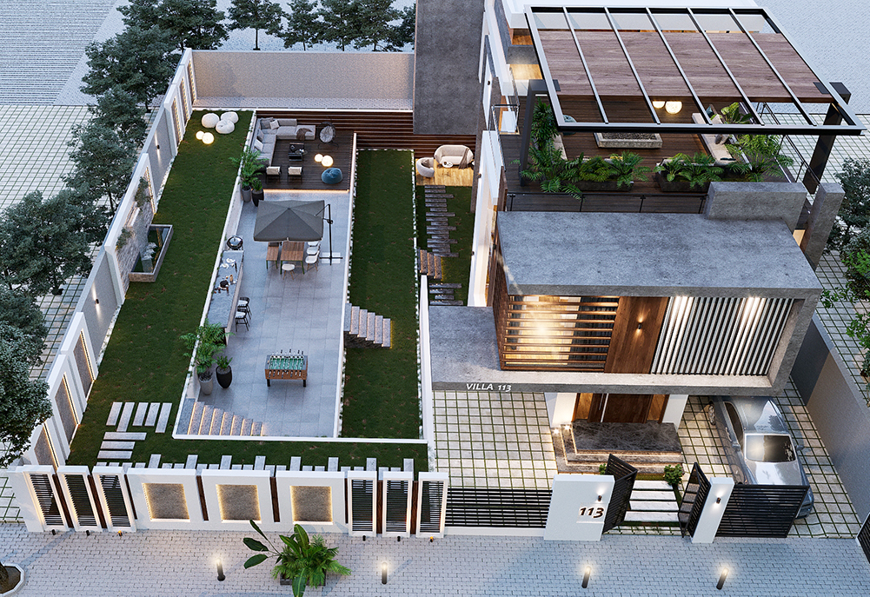
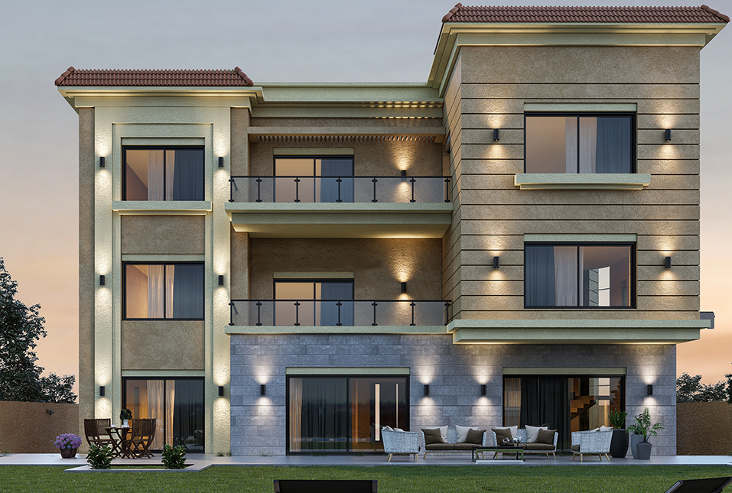
EXTERIOR & LANDSCAPE DESIGN
Notes:
We produce exterior and landscape shots, shop drawings, BOQs, specifications, and more… for residential, commercial, administrative buildings

Slide 14
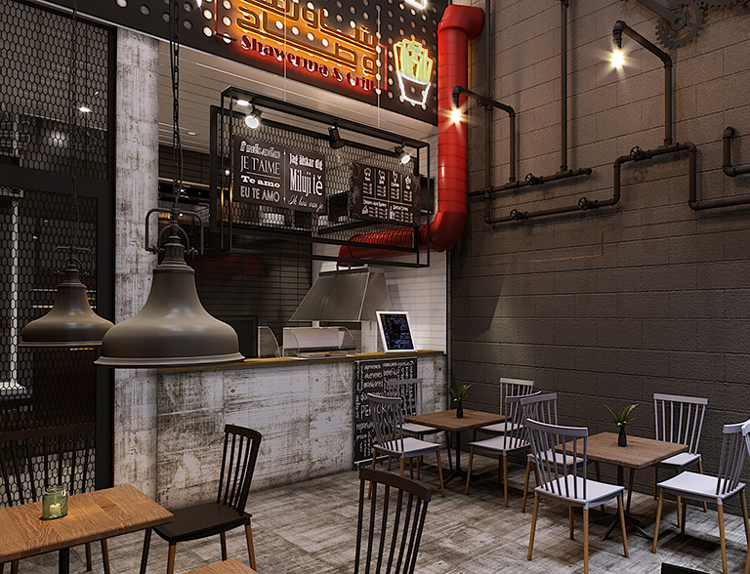




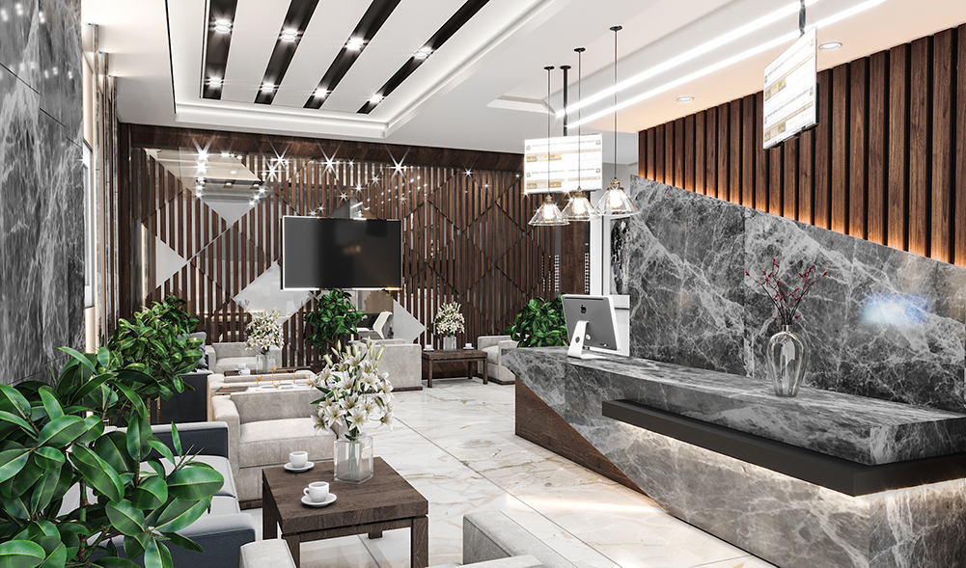
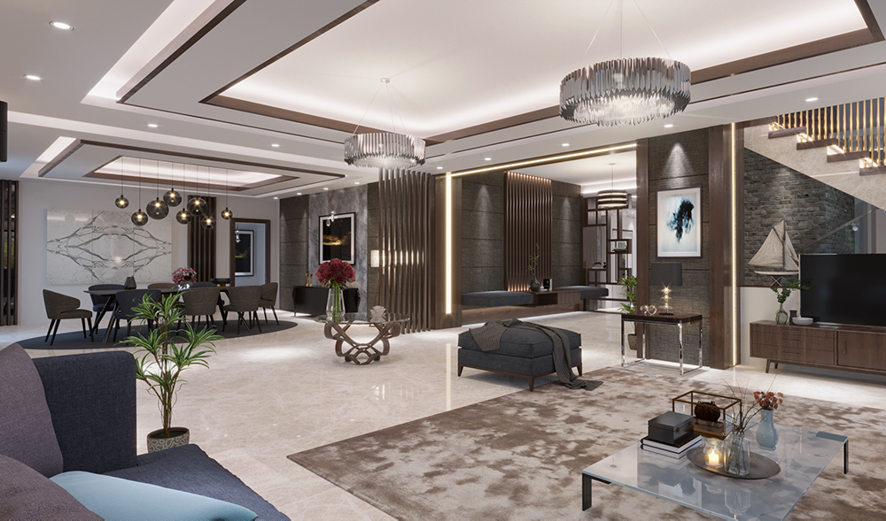

INTERIOR DESIGN
Notes:
We produce interior shots, shop drawings, BOQs, furnishing details, specifications, and more… for residential, commercial, administrative buildings

Slide 15
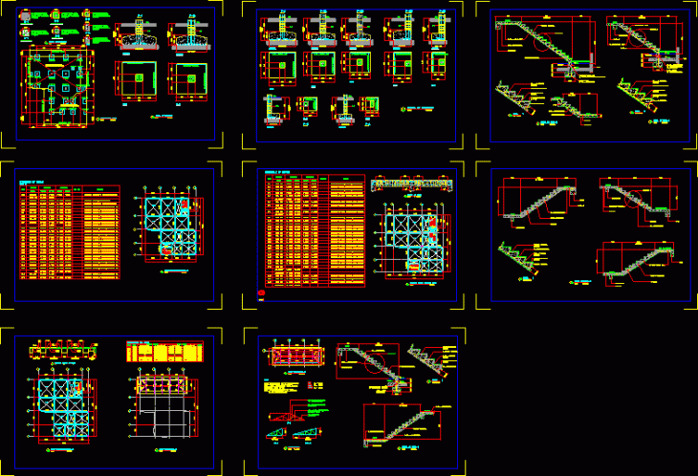
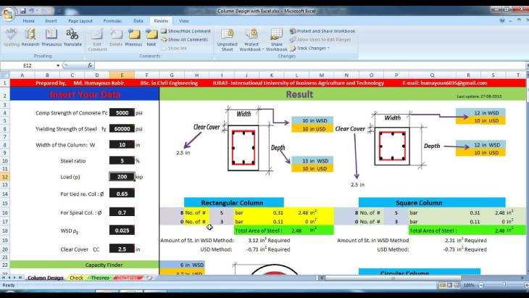
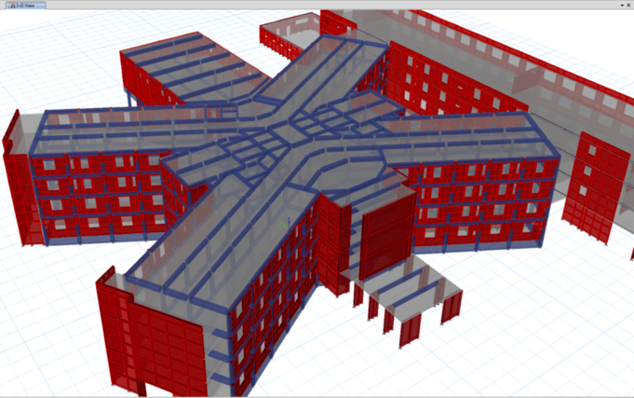
STRUCTURAL DESIGN
Conceptual Design
Calculate Internal Forces
Iterative Design
Foundation Design
Drafting
Notes:
We produce conceptual designs that best fit the architectural design provided, and coordinate all structural element locations with the architectural concept.
Then we calculate the internal forces of each element in order to determine our material selection and design techniques.
After finalizing the iterative design, we calculate the stressors on underlying soil and design the foundational footings.
Finally, we produce full calculation sheets & design drawings

Slide 16
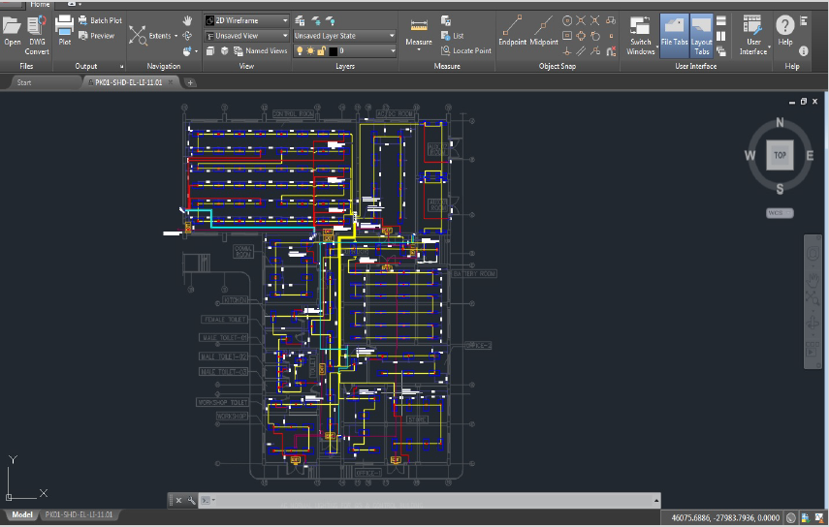
ELECTRICAL DESIGN
Electrical MV & LV Networks & Distribution Systems, Switchgears, RMUs, Cabling, Schematic Drawings & SLDs
Selectivity & Discrimination Studies
Transformers & Cable Sizing
Short Circuit & Voltage Drop Calculations
Notes:
We provide…
Electrical Medium Volt & Low Volt networks and distribution systems, switchgears, Ring Main Units, cabling, schematic drawings and Single Line Diagrams.
Selectivity and Discrimination studies.
Transformers and Cable Sizing.
Short Circuit and Voltage drop calculations.

Slide 17
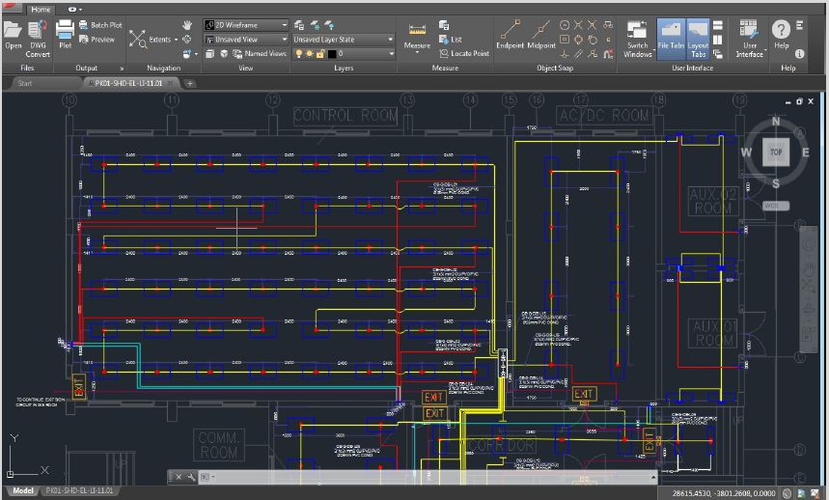
ELECTRICAL DESIGN
Raceway Designs
Lighting System Designs & Calculations
Power System Designs & Calculations
Panel Board Scheduling
Notes:
We produce…
Raceway Designs (Ladders, Trays, Conduits... etc.)
Lighting system designs and calculations (Interior, roads, facade and landscape) VIA DiaLux.
Power system designs and calculations according to applied standards (Risers, Receptacles and outlets)
Panel Board Scheduling

Slide 18
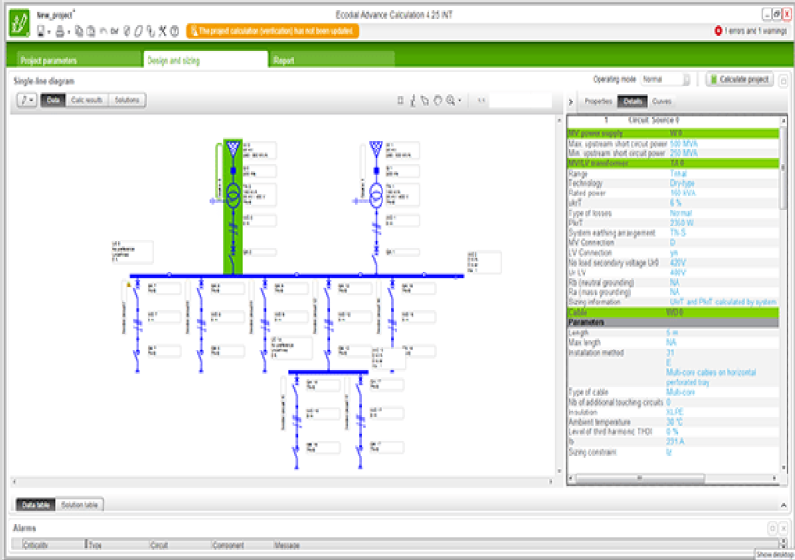
ELECTRICAL DESIGN
Shop Drawings & Installation Detailing
Earthing & Lightning System Designs
Emergency System Designs
Notes:
We provide shop Drawings for all electrical systems, installation details according to standards, regulations & project specs.
Earthing & Lightning System Designs
Emergency system designs

Slide 19
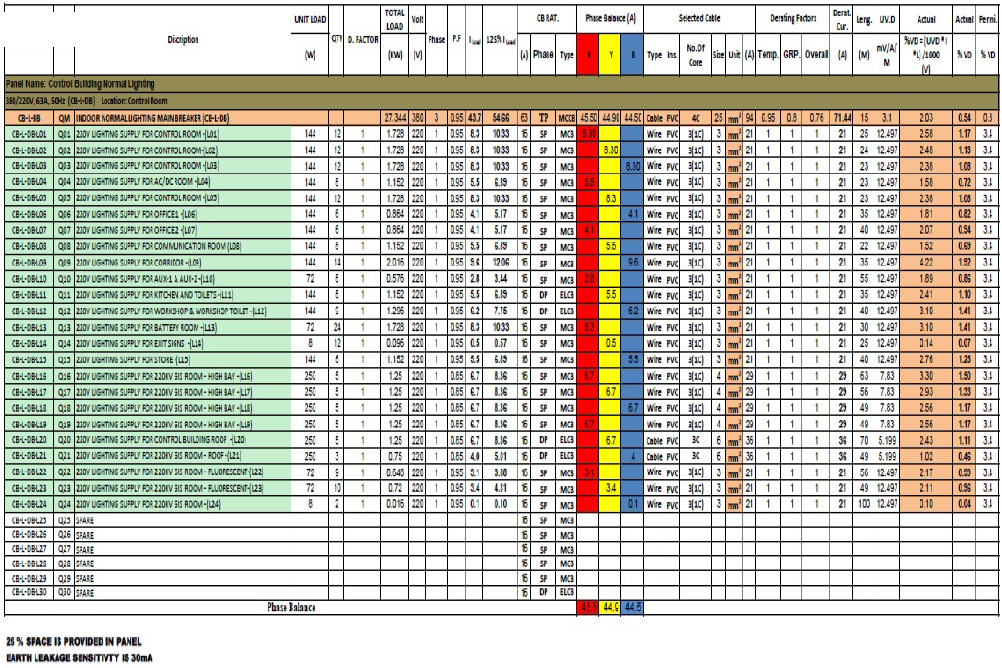
ELECTRICAL DESIGN
Light Current Systems:
  Fire Alarm Systems
  Communication Systems
  Closed Circuit TV Security System(cctv)
  Access Control Systems & Security Systems (ACS)
Notes:
Light Current systems including but not limited to:
Fire alarm system.
Communication systems (Data, Telephone).
Sound systems.
Closed circuit TV security system(CCTV)
Access door system security system (ACS)

Slide 20
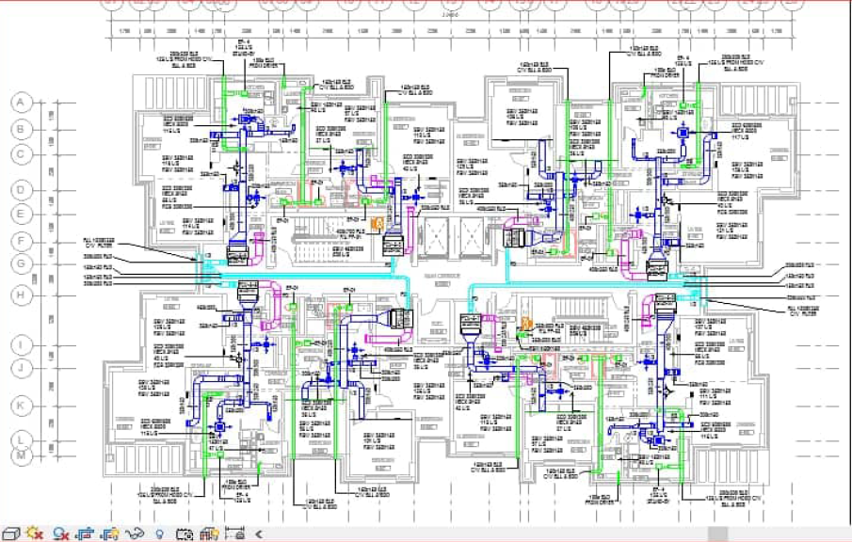
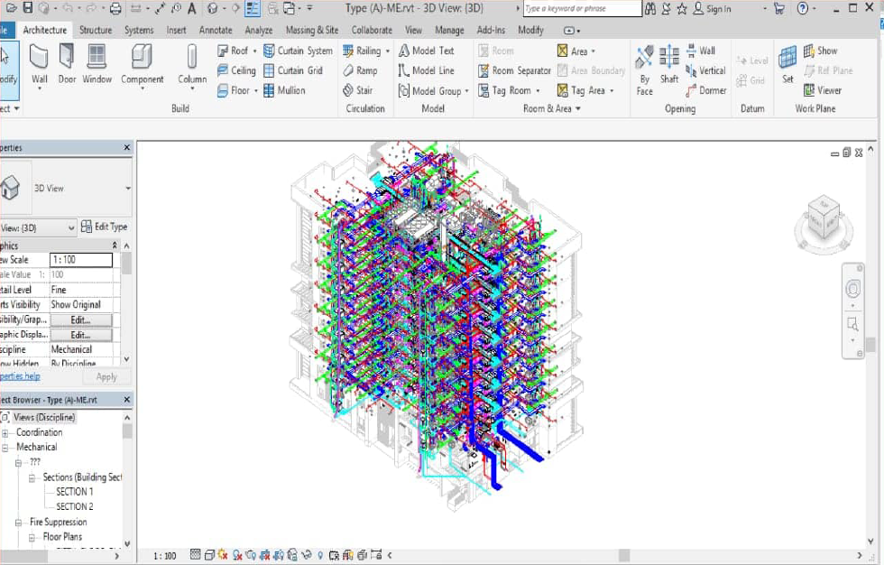
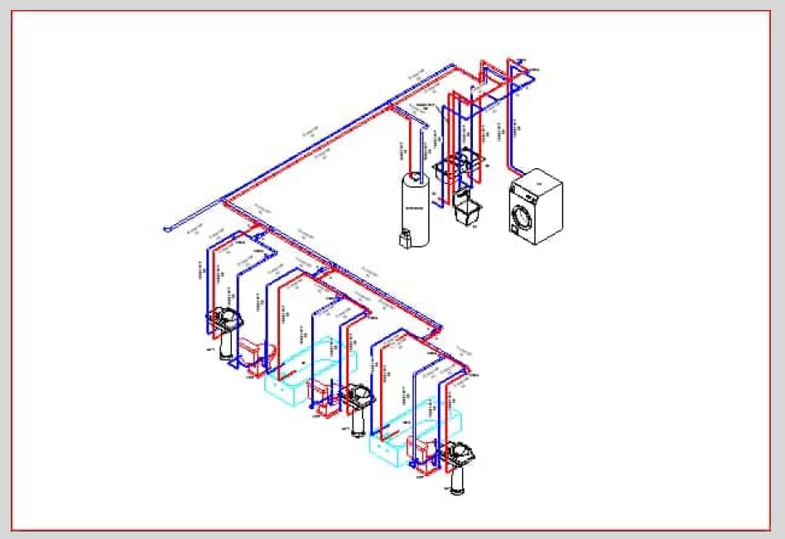
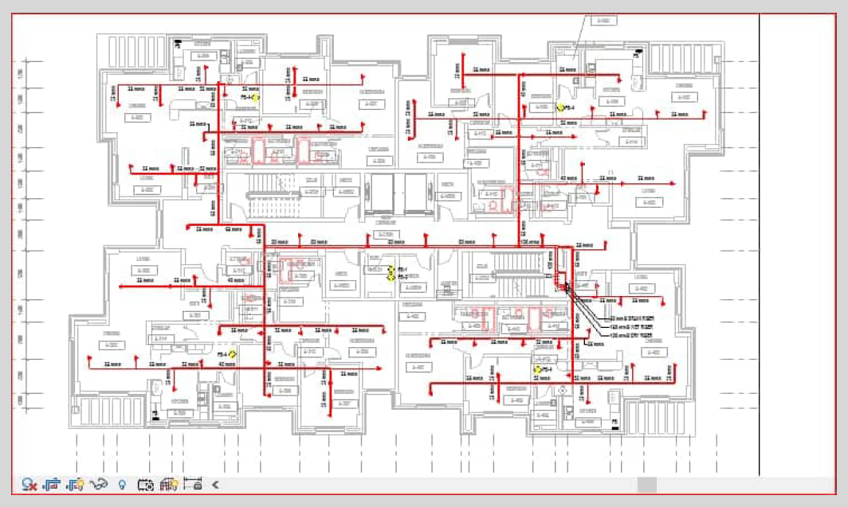
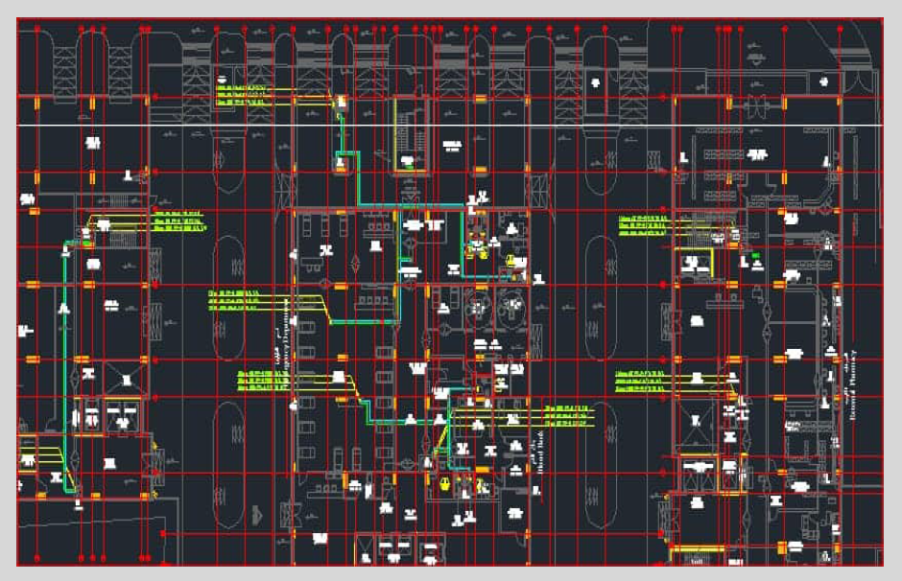
MECHANICAL DESIGN
We provide designs & shop drawings:
  Fire fighting systems.
  Water supply systems.
  Drainage systems.
  HVAC systems.
Notes:
We provide designs & shop drawings for all mechanical aspects of construction projects:
Including but not limited to:
Fire fighting systems.
Water supply systems.
Drainage systems.
HVAC systems.

Slide 21

TIME IS MONEY $$$
Let HOME | C&D get started improving your business NOW, so you see results TODAY!

