Slide 1


HOME | Creations & Development
Hydrological Studies provider of choice
Notes:
Welcome, This is the introductory presentation to Home Creations & development’s Hydrological studies methodology & results.

Slide 2
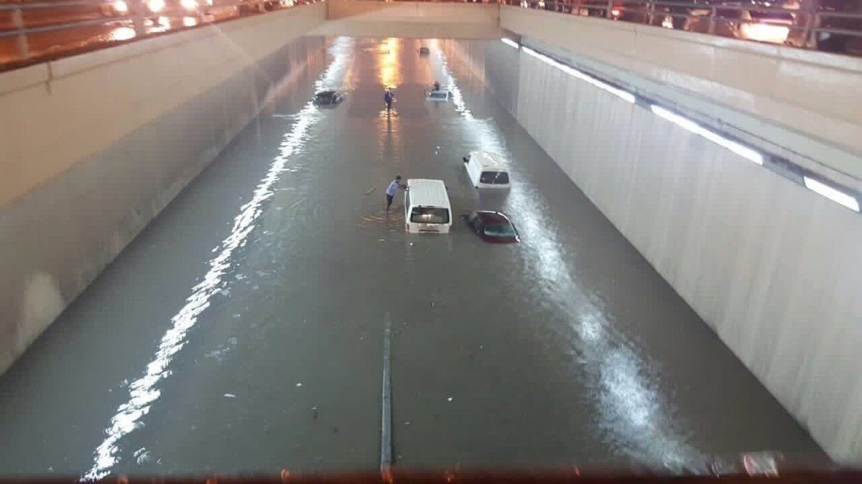
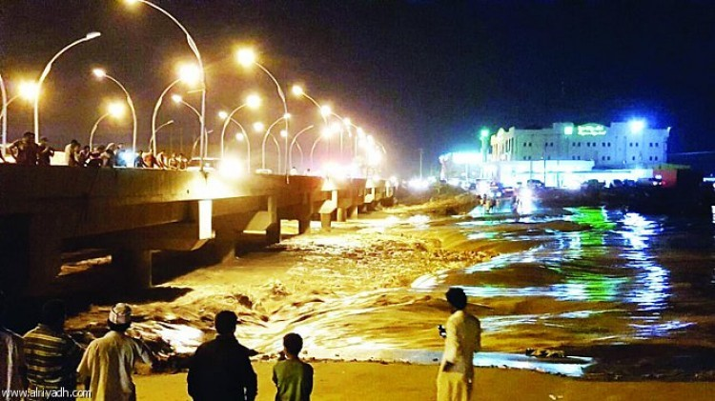
Risks & Threats
Floods and deluges threaten urban expansion across the Kingdom
Nearby mountains or deserts increase risks significantly
Extreme water conditions cause damage and destruction of private property and public infrastructure.
In large volumes, rushing water can reach high speeds putting inhabitants in danger.
Notes:
Floods and deluges are among the most significant threats facing urban expansion in various regions of the Kingdom.
This is especially true of any habitation or land usage surrounded by mountainous and/or desert topography,
Flooding and rainfall are the most consequential determinants and dangers permeating these mountainous areas at irregular intervals,
which expose urban communities and transportation networks to extreme economic loss and negative effects.

Slide 3
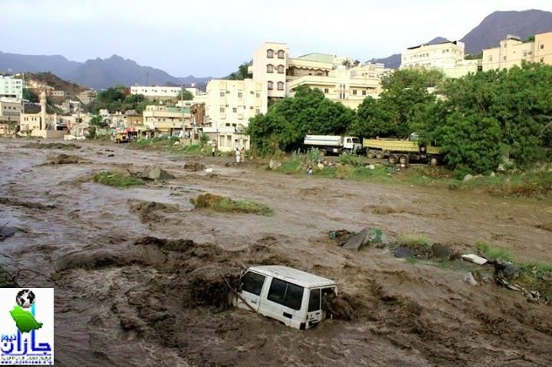
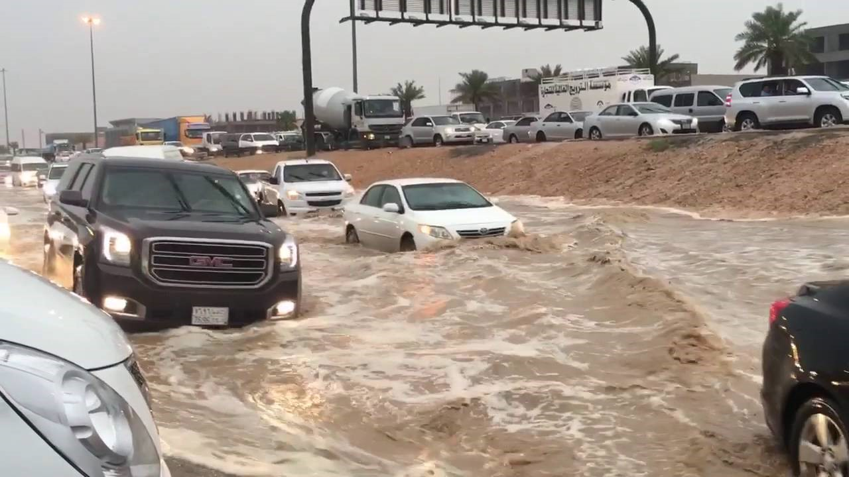
Risks & Threats
Regardless of whether the development is the continuation of a pre-existing network or the creation of new networks and roads,
risks, impact and protection must be carefully calculated before commencing urban planning or establishing any central or regional road networks,
Notes:
Occasionally, extreme water conditions cause flooding or destruction of infrastructure.
Under such conditions, rushing water may reach such high speeds that inhabitants are endangered.
Risks, impact and protection must be carefully calculated before commencing urban planning or establishing any central or regional road networks,
And regardless of whether the development is the continuation of a pre-existing network or the creation of new networks and roads.
Flooding and rainfall are the most consequential determinants and dangers permeating these mountainous areas at irregular intervals,
which expose urban communities and transportation networks to extreme economic loss and negative effects.

Slide 4
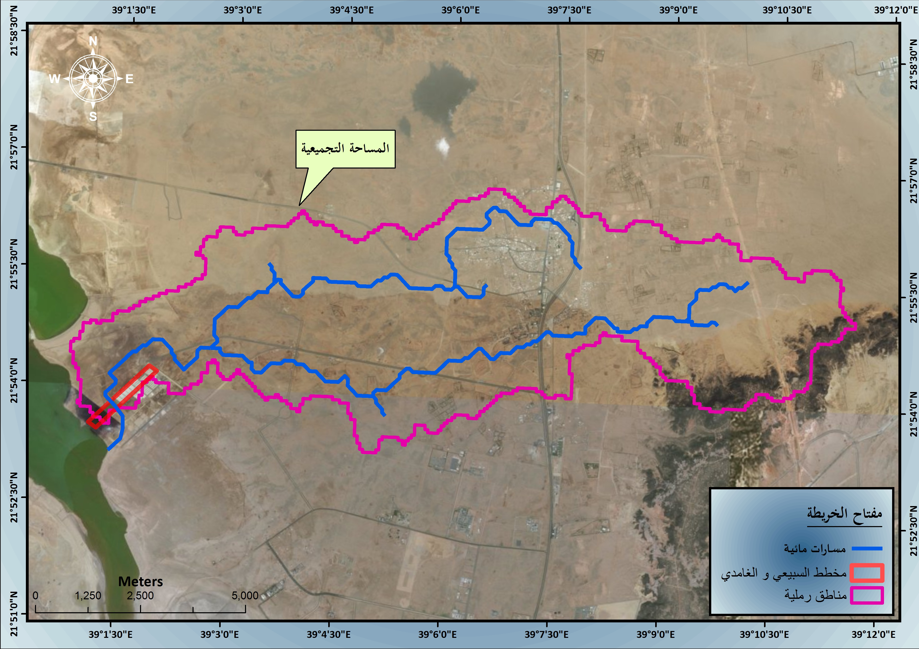
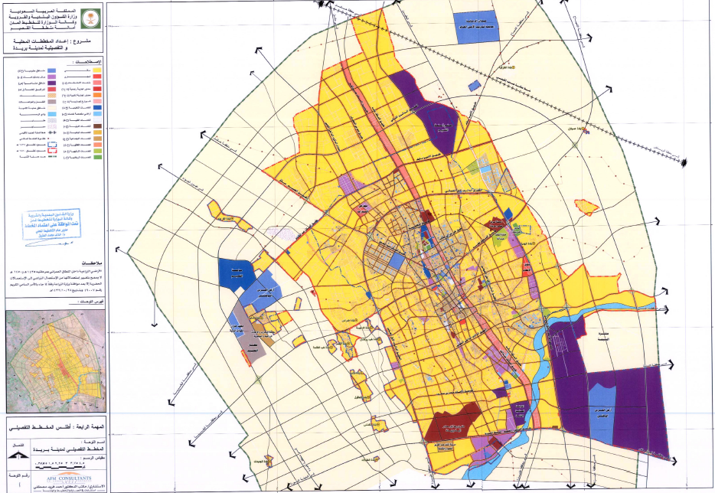
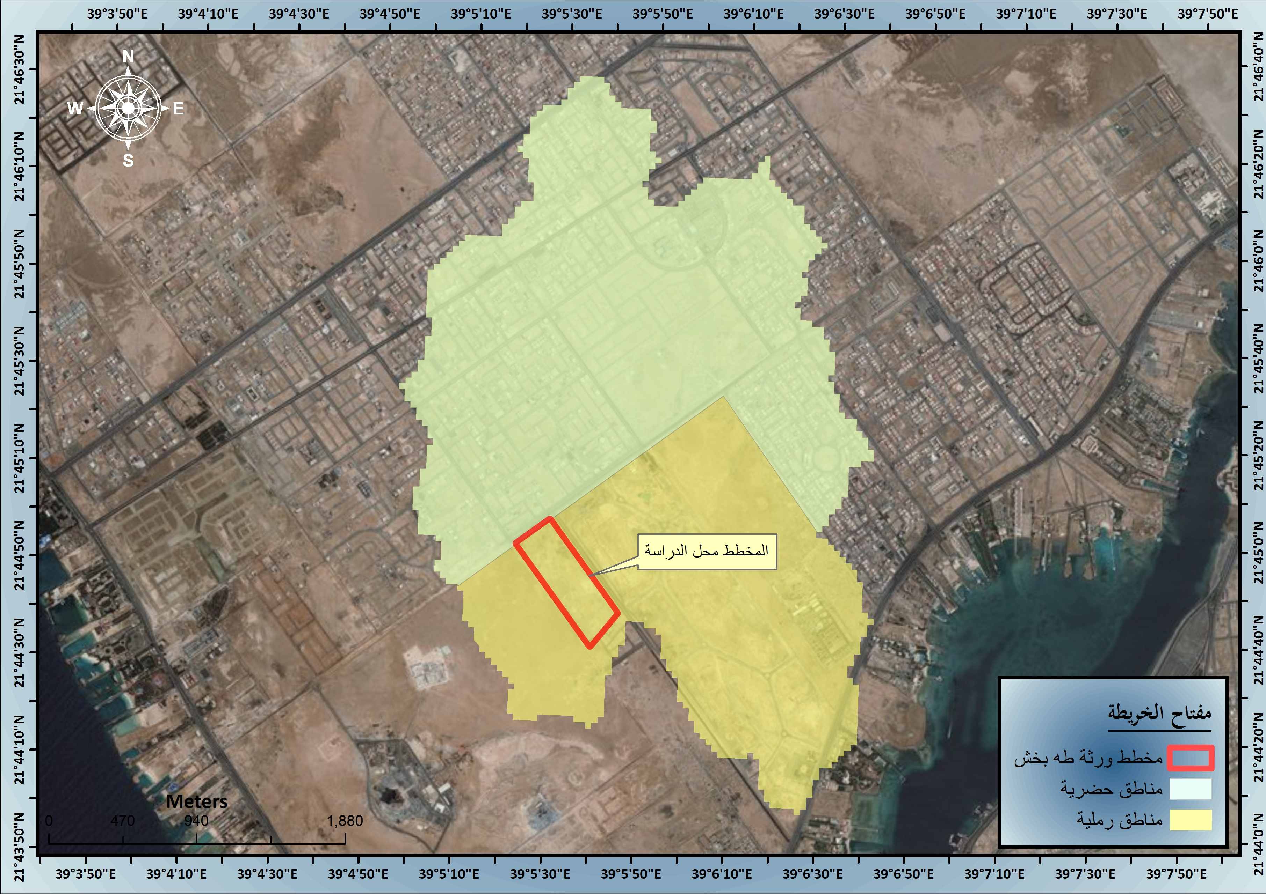
Influencing Factors
Factors affecting floods & flood behavior:
Area of drainage basin and its characteristics
Land use within the drainage
Types of vegetation arising from within the drainage basin
Notes:
The most important factors that affect floods and flood behavior are:
Area of drainage basin and its characteristics
Land use within the drainage
The types of vegetation arising from within the drainage basin

Slide 5

Reliable Solutions
Designs & schemes produced from best-in-industry studies
Full compliance with Ministry of Municipal & Rural Affairs standards & regulations
400+ approved studies issued throughout the Kingdom

Slide 6
Hydrologic Study Procedure
Topographic Study & Survey Works
Geological Study & Land Use Maps
Metrological Study & Rainfall Data Analysis
Morphological Study
Hydrological Modeling
Suggested Alternatives for Solutions

Slide 7
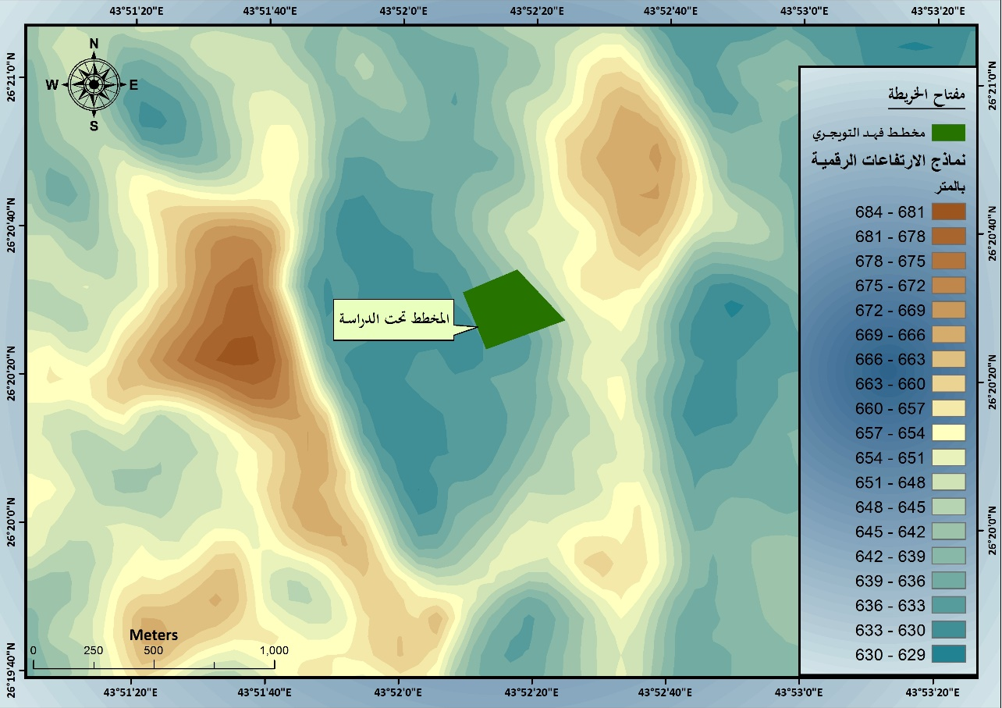
Topographic Study & Survey Works
Methods: Topographic data and survey analysis.
Technology: A digital elevation model of the study area, with a precision of ​​10 meters (WGS84),
Determinations: Paths of wadis and streams, land surface gradients, slopes, boundaries and characteristics of drainage basins.

Slide 8
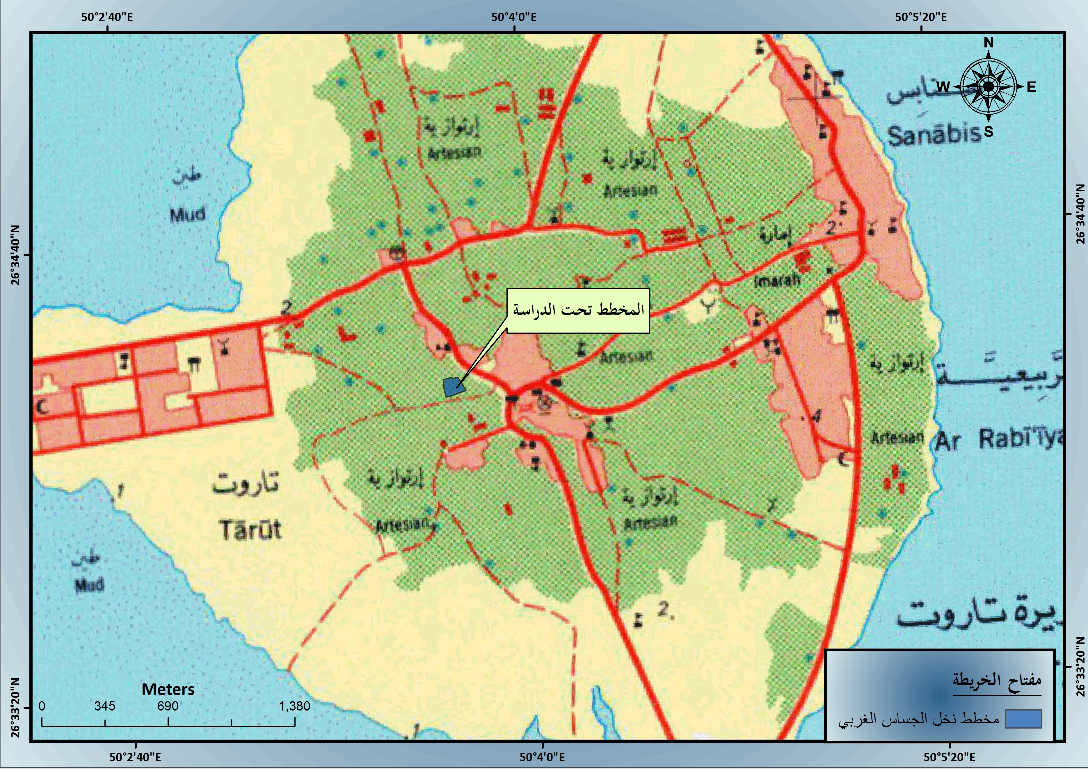
Topographic Study & Survey Works
With topographic maps produced by SGS, we identify principal land features that affect and threaten the study area.

Slide 9
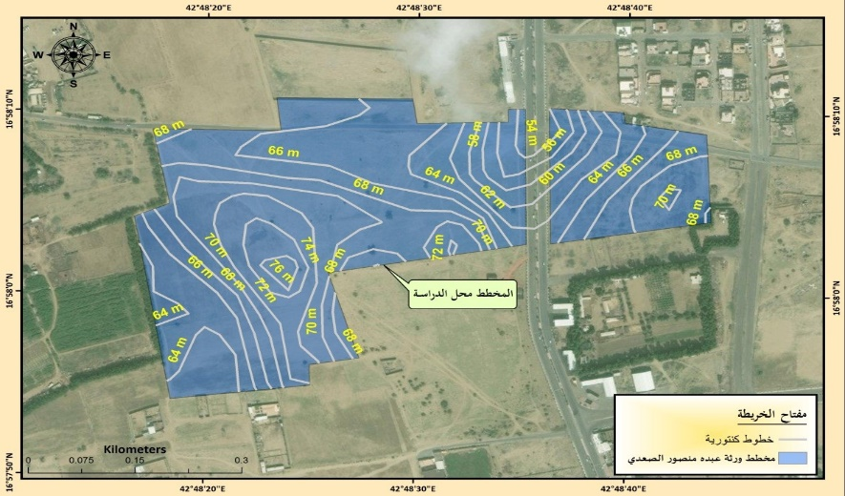
Topographic Study & Survey Works
A detailed topographic survey & resulting data are used to:
design preemptive measures, and
engineer alternatives for protection from flood hazards.
A detailed survey of streets is used for:
design of storm drainage networks
Notes:
A detailed topographic survey and the resulting data is required for the design of preemptive measures and engineered alternatives for protection from flood hazards.
A detailed survey of the streets in the study area is also considered essential to the design of storm drainage networks.

Slide 10
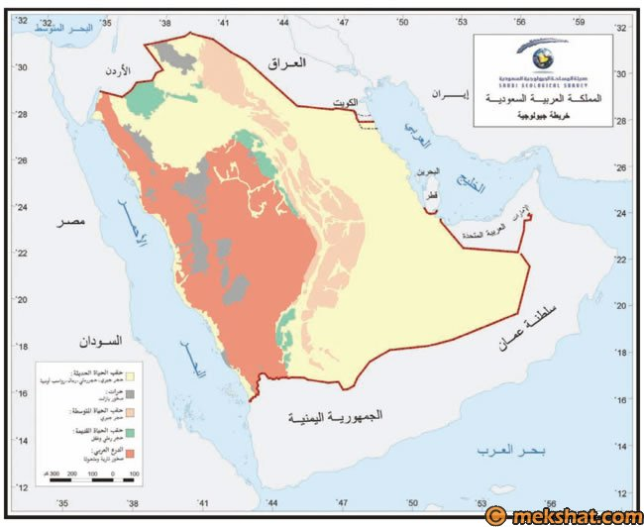
Geological Study & Land Use Maps
The main objective of a geological and land use study is to calculate the Curve Number (CN) to estimate the values ​​of the expected flood water flow, and to identify the current and potential land usage within ​​the drainage basin that can affect the surface flow rates of flood water and rain.
Notes:
The main objective of a geological and land use study is to calculate the Curve Number (CN) to estimate the values ​​of the expected flood water flow using the characteristics of the surface soil and to identify the current and potential land usage within ​​the drainage basin that can affect the surface flow rates of flood water and rain.

Slide 11
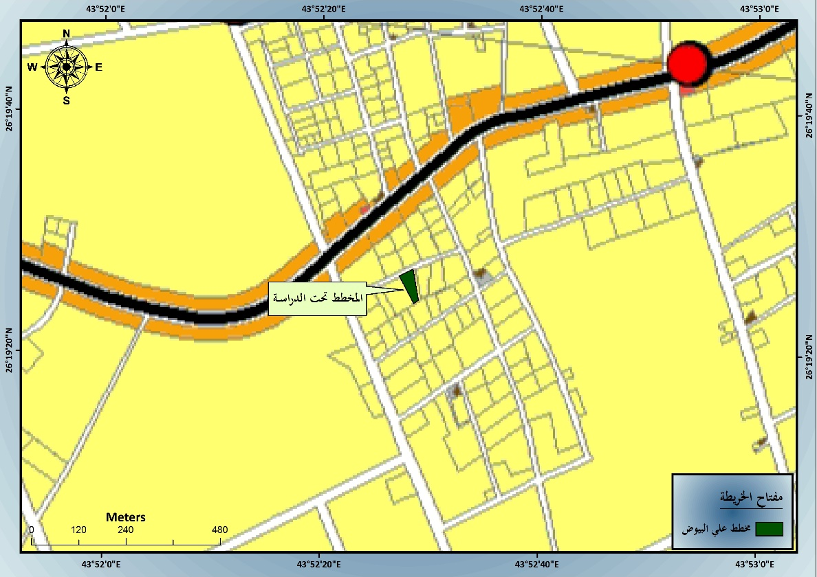
Geological Study & Land Use Maps
To define the characteristics of the surface soil and land usage, we use:
geological maps & satellite images (Google Earth)
soil maps & land use maps produced by the Ministry of Agriculture.

Slide 12
Metrological Study &
Rainfall Data Analysis
Hydrologic studies are based mainly on measurements of the amount of rainfall collecting in the drainage basin that affect the study area.
The intensity and depth of rainfall falling on the drainage basin affecting the study area is one of the most important elements used to calculate the expected water flow.
Rainfall data previously recorded at monitoring stations close to the drainage basin is used in preparation for flood drainage projects.

Slide 13
Metrological Study &
Rainfall Data Analysis
Section Summary:
Analysis of the rainfall data for the stations close to the scheme under study & selecting the appropriate distribution that achieves the lowest standard error

Slide 14
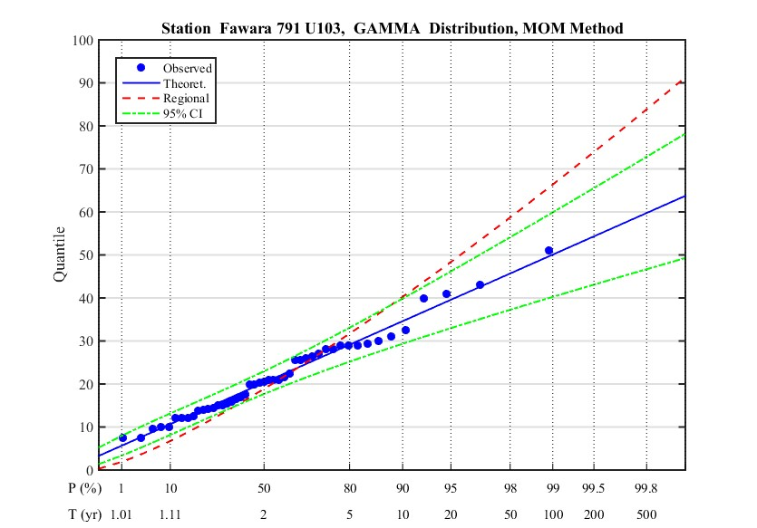
Metrological Study &
Rainfall Data Analysis
Section Summary:
Analysis of the rainfall data for the stations close to the scheme under study and selecting the appropriate distribution that achieves the lowest standard error
Determination of the values ​​of the design rain depth for the different return periods 2, 5, 10, 25, 50 & 100 years

Slide 15
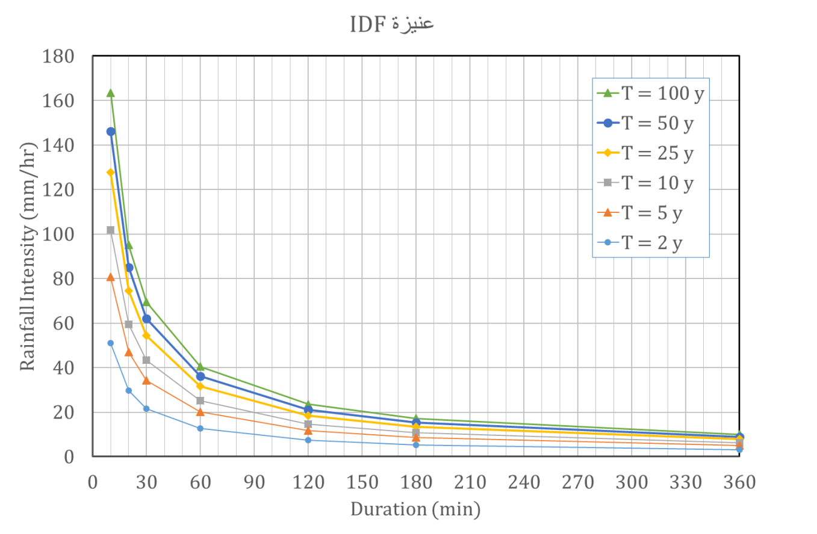
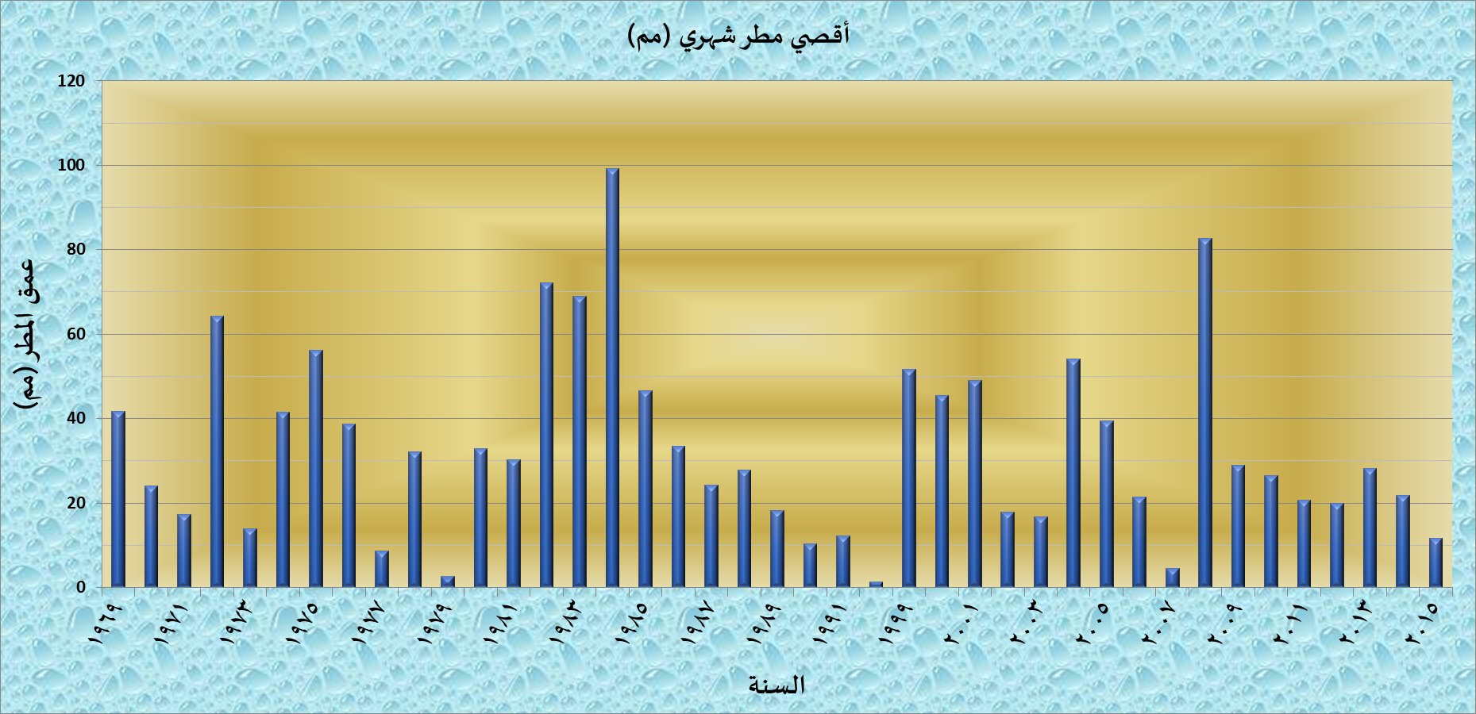
Metrological Study &
Rainfall Data Analysis
Section Summary:
Analysis of the rainfall data for the stations close to the scheme under study and selecting the appropriate distribution that achieves the lowest standard error
Determination of the values ​​of the design rain depth for the different return periods 2, 5, 10, 25, 50 and 100 years
Conclusion of the intensity, depths, frequency curve (IDF) used in the design of drainage networks proposed in the scheme under study.

Slide 16
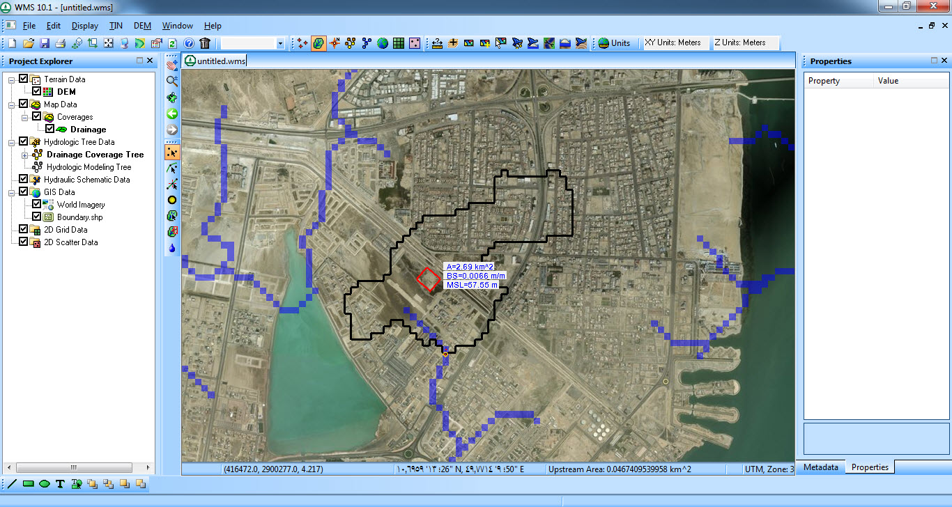
Morphological Study
Method: Collection & analysis of topographic, morphological maps & digital elevation models.
Technology: Geographic information systems (GIS) and satellite images.
Qualitative & Quantitative Analyses:
Nature of the earth's surface, slopes & deviations
Nature of Wadi drainage basin, topographic average slope, highest & lowest level, & longest path.
Notes:
Morphological studies are concerned with the collection and analysis of topographic, morphological maps and digital elevation models, using geographic information systems (GIS) and satellite images to analyze the nature of the earth's surface, slopes, deviations in the levels and areas of scheme.
Qualitative and quantitative analyses of the wadi drainage basin, calculation of the topographic average slope, calculation of the highest and the lowest level of the wadi, as well as the longest path of the wadi are also carried out.

Slide 17
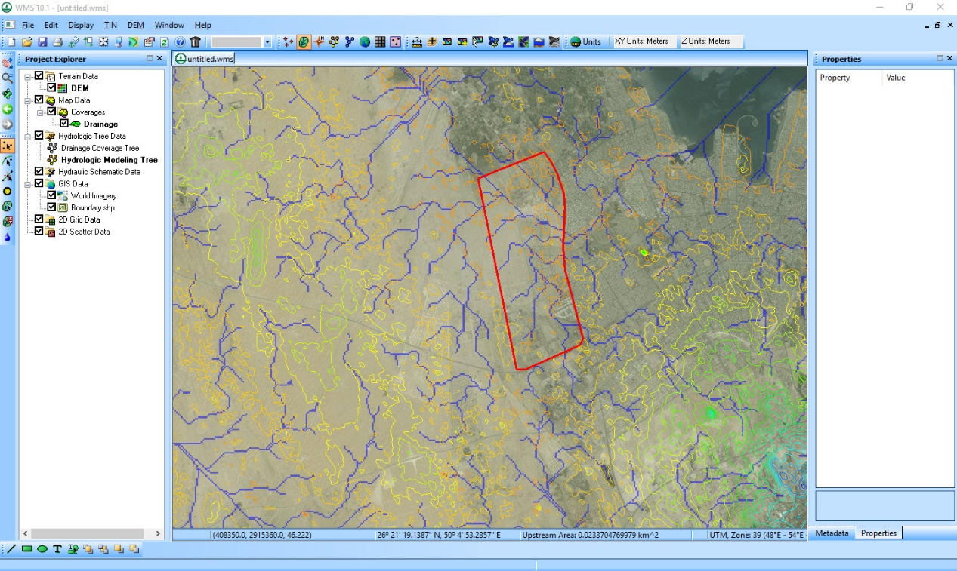
Morphological Study
Section Summary:
Drainage basins and waterways affecting the planned scheme derived from Watershed Modeling System (WMS) or its equivalent

Slide 18
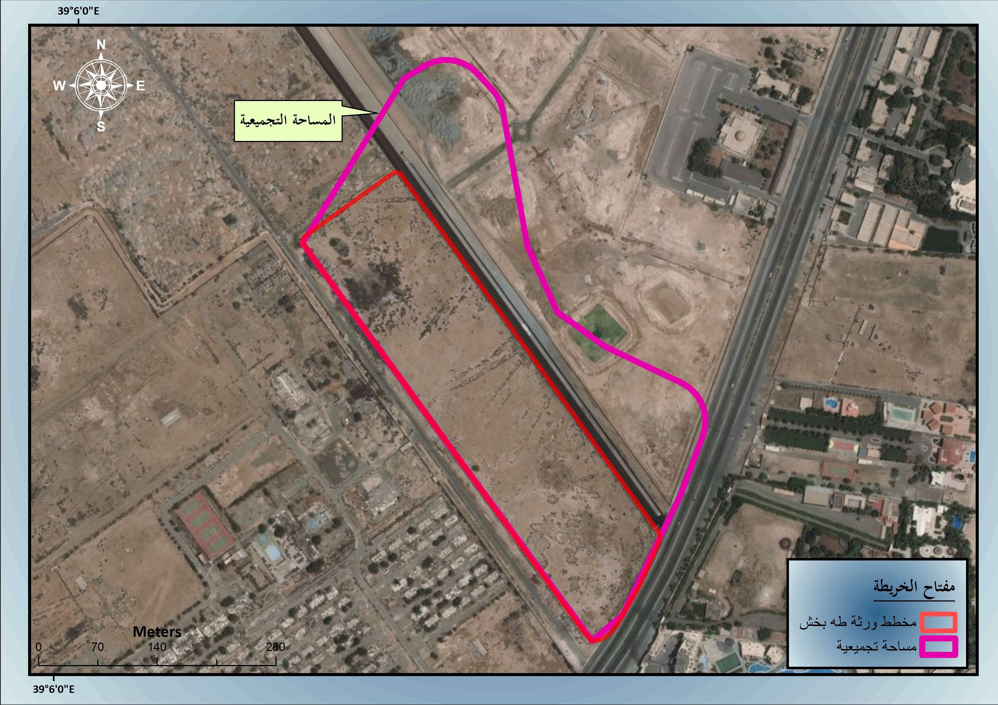
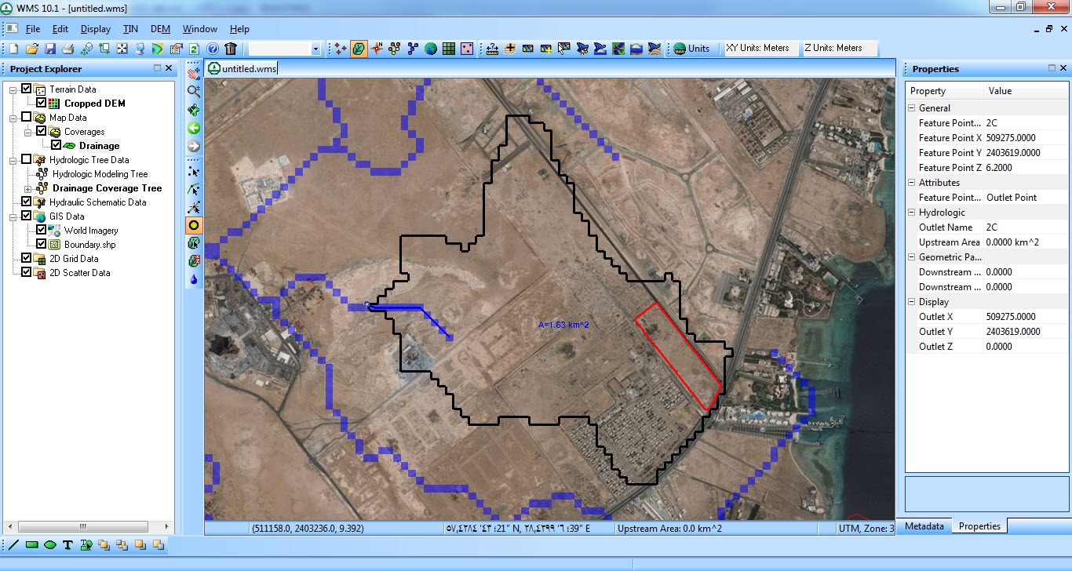
Morphological Study
Section Summary:
Drainage basins and waterways affecting the planned scheme derived from Watershed Modeling System (WMS) or its equivalent;
Manual verification of the results from the WMS of all drainage basins affecting the scheme.

Slide 19
Morphological Study
Section Summary:
Drainage basins and waterways affecting the planned scheme derived from Watershed Modeling System (WMS) or its equivalent;
Manual verification of the results from the WMS of all drainage basins affecting the scheme.
The conclusion of all morphological characteristics affecting the scheme under study area of ​​the collection basin.

Slide 20
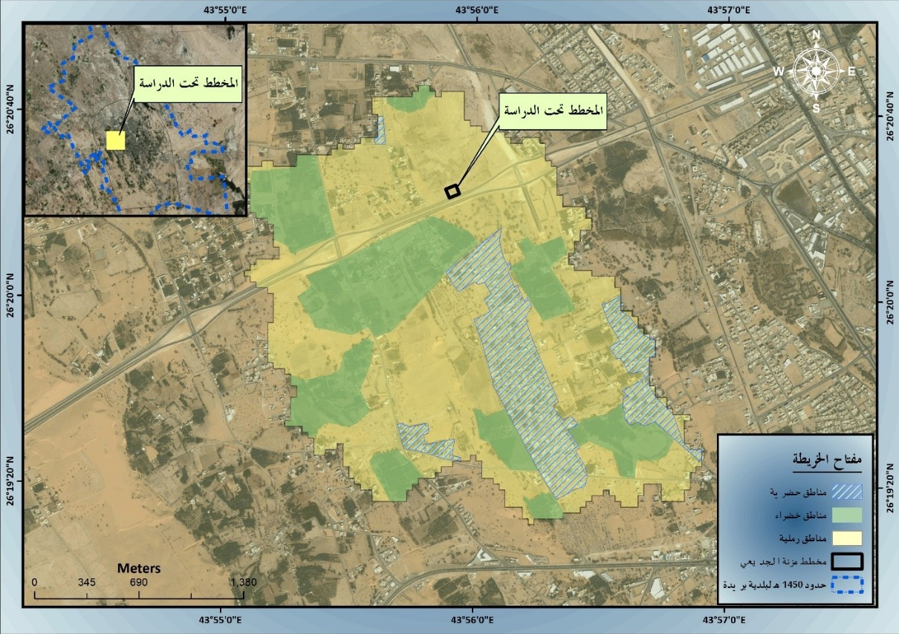
Morphological Study
Section Summary:
Drainage basins and waterways affecting the planned scheme derived from Watershed Modeling System (WMS) or its equivalent;
Manual verification of the results from the WMS of all drainage basins affecting the scheme.
The conclusion of all morphological characteristics affecting the scheme under study area of ​​the collection basin,
Determine the CN of all drainage basins by using the soil type and the land uses of the area

Slide 21
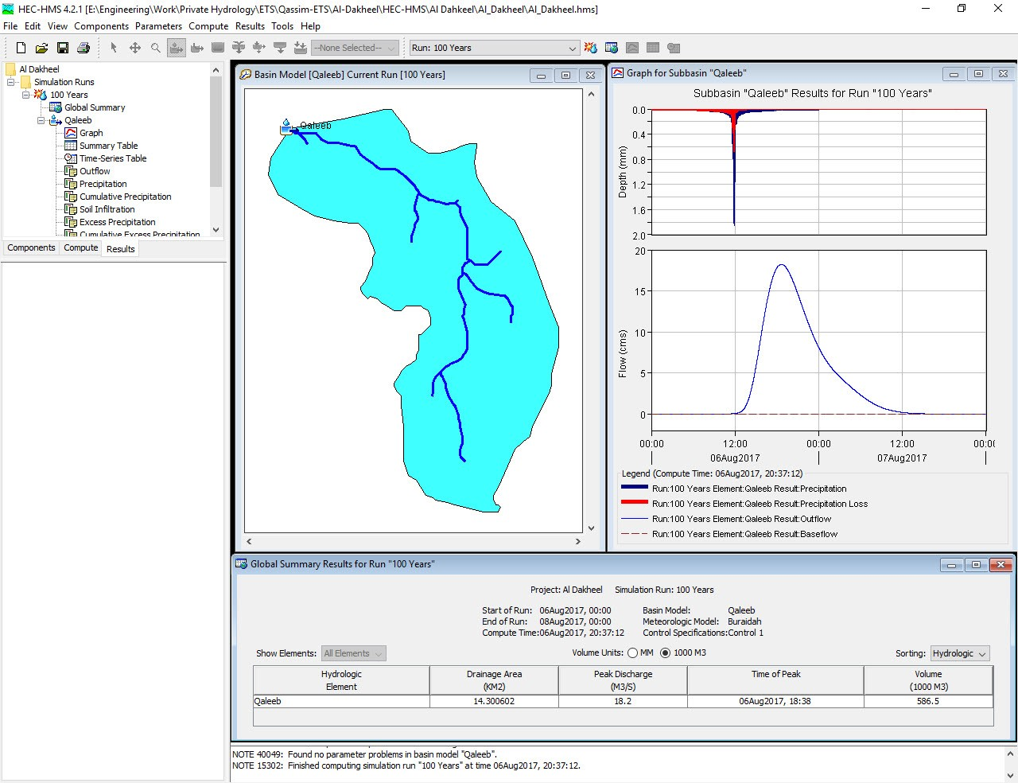
Hydrological Modeling
Section Summary:
The area of ​​each drainage basin is used to find out the appropriate method of calculating the expected flow rate, either using SCS or the Rational Method.
Maximum quantities of disposal from drainage basins for different return periods using the HEC-HMS software;

Slide 22
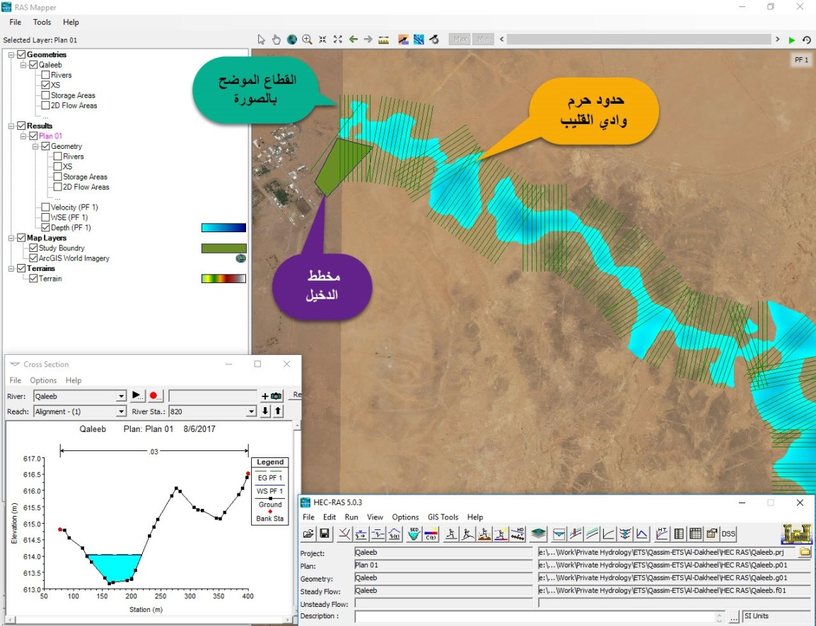
Hydrological Modeling
Section Summary:
The area of ​​each drainage basin is used to find out the appropriate method of calculating the expected flow rate, either using SCS or the Rational Method .
Maximum quantities of disposal from drainage basins for different return periods using the HEC-HMS software;
Identification of the floodplain affecting the scheme studied through the HEC-RAS software.

Slide 23
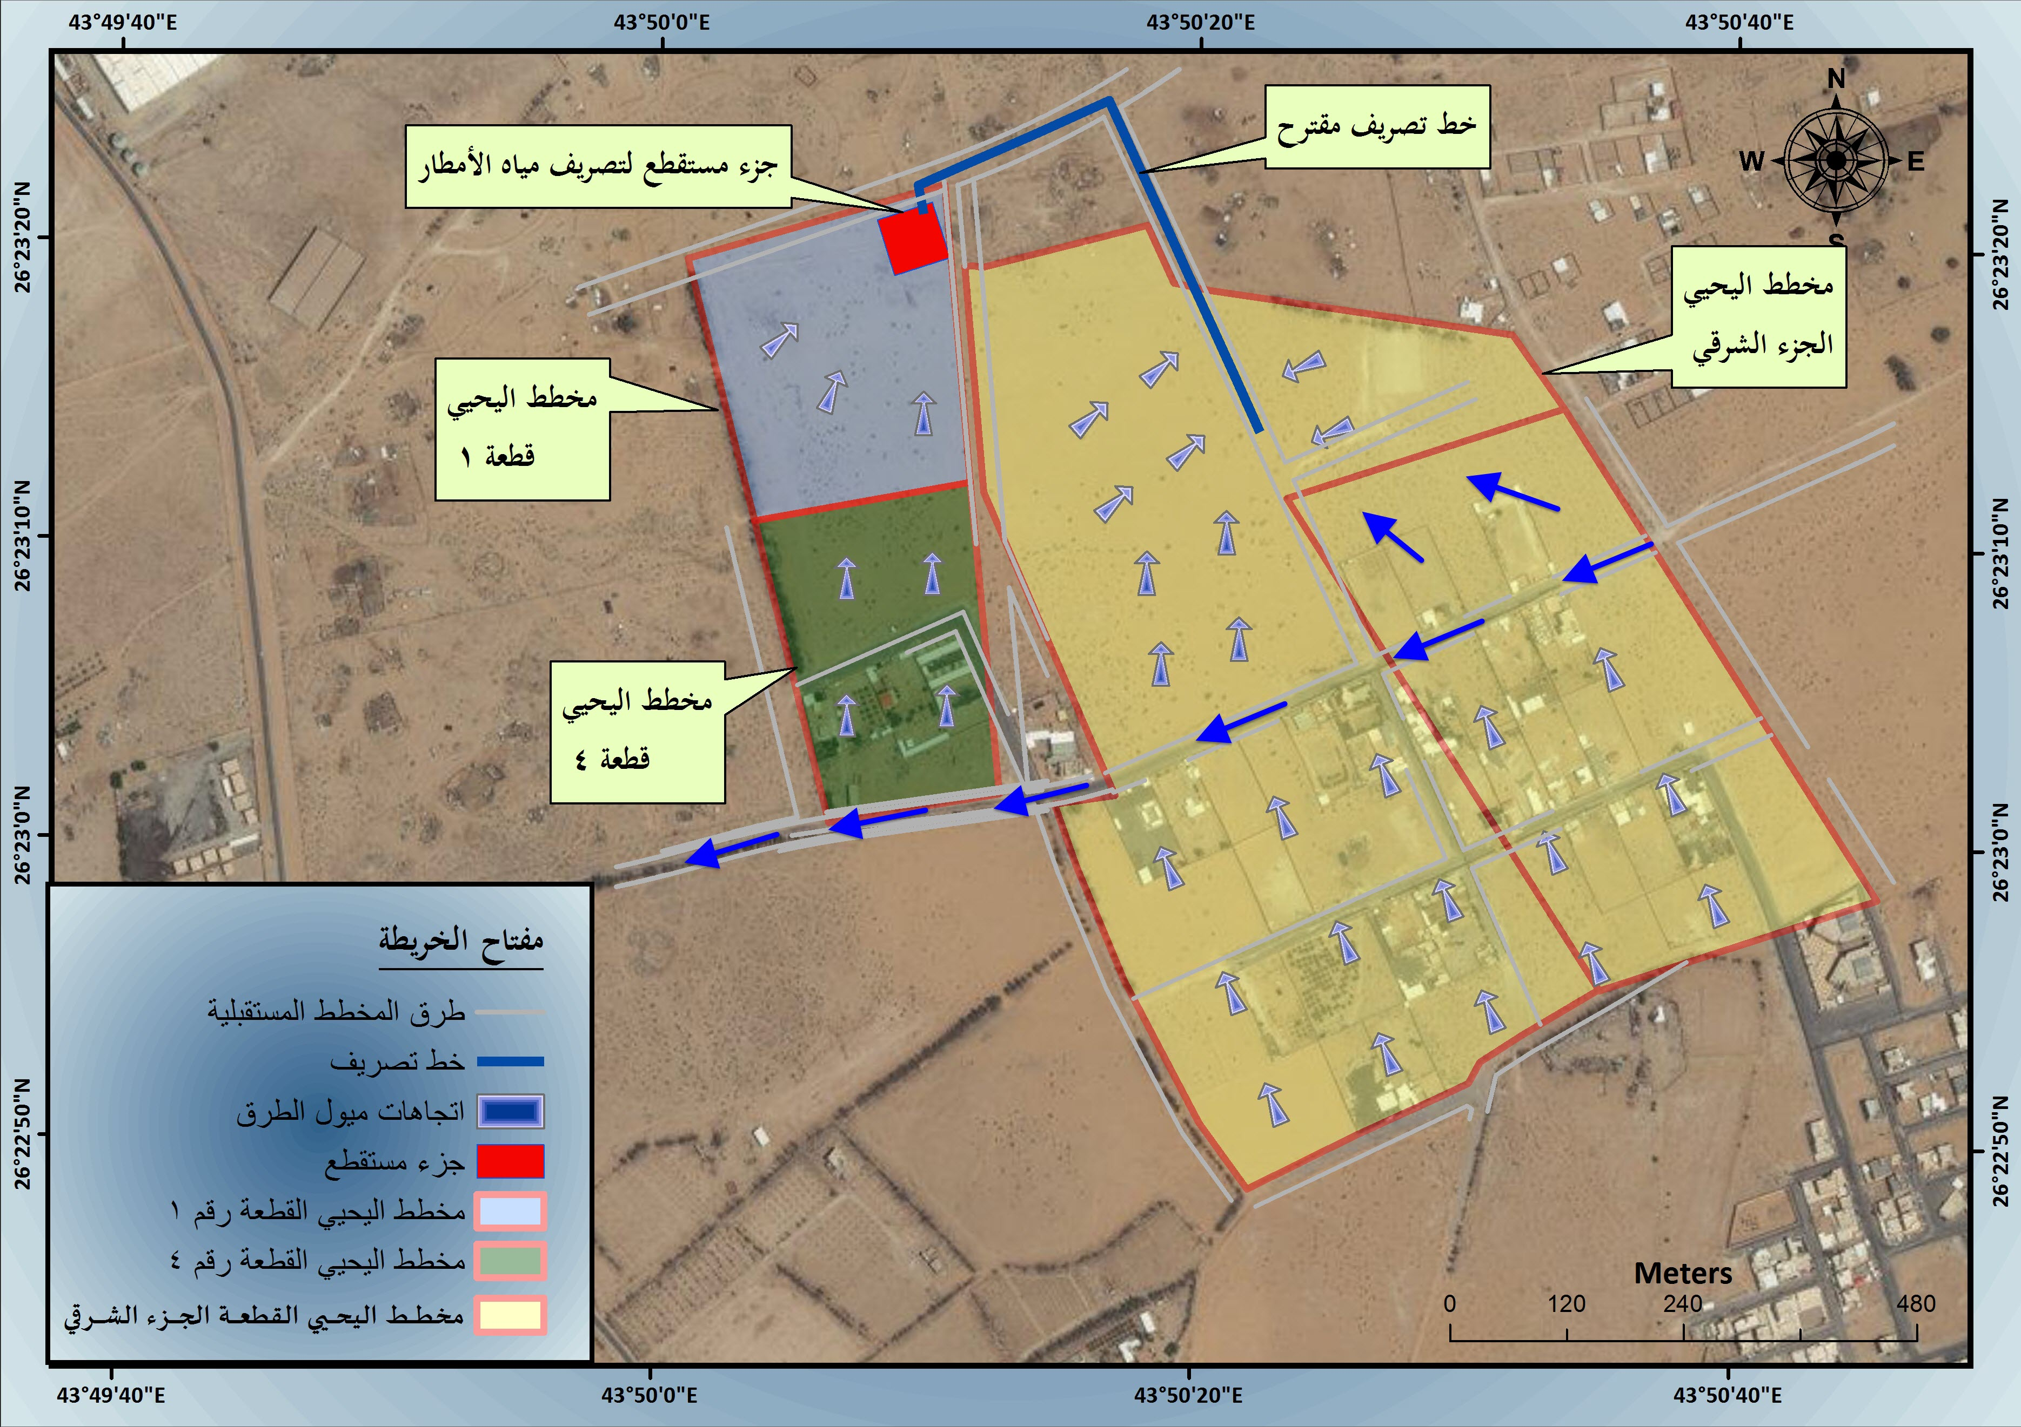
Alternative Solutions
Section Summary:
Recommendations for alternatives to the proposed solutions to protect the desired scheme from flood hazards and rainwater drainage;

Slide 24
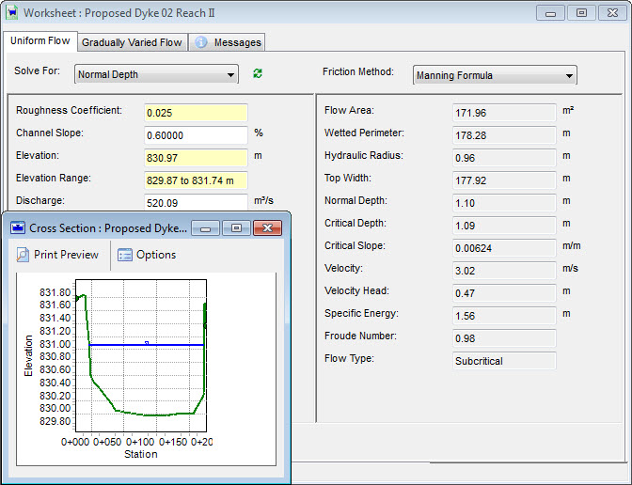
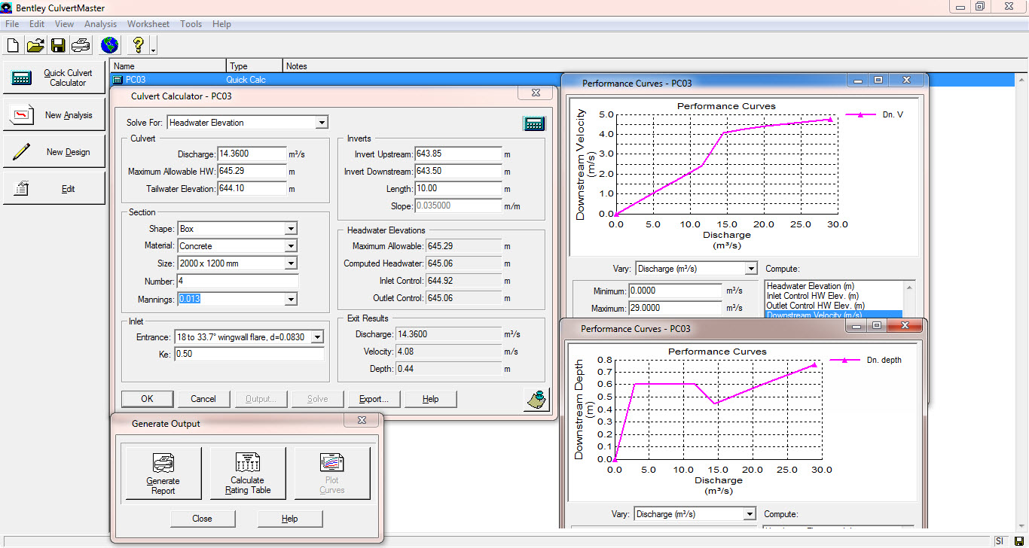
Alternative Solutions
Section Summary:
Recommendations for alternatives to the proposed solutions to protect the desired scheme from flood hazards and rainwater drainage;
Production of hydraulic models of the proposed solutions, using FlowMaster and Culvert Master Software;

Slide 25
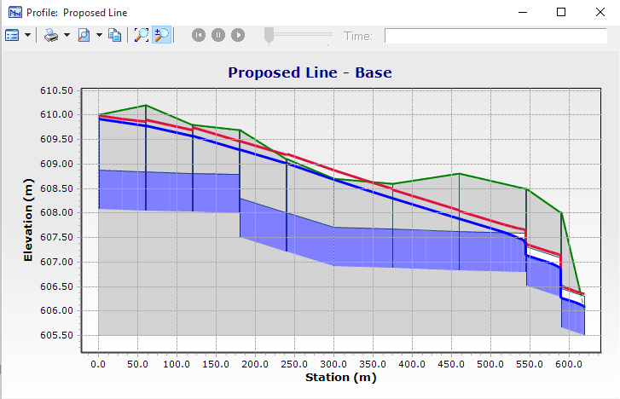
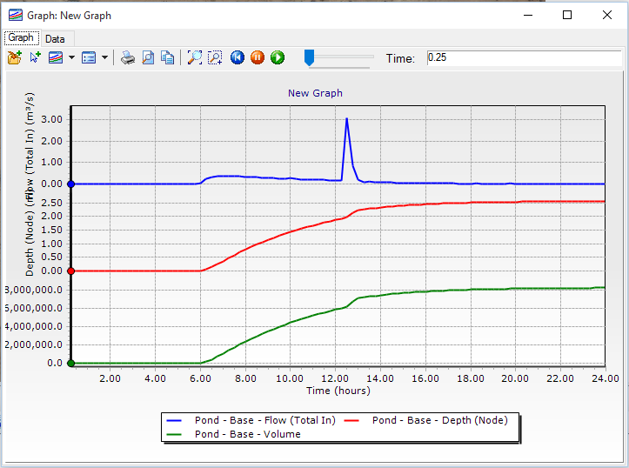
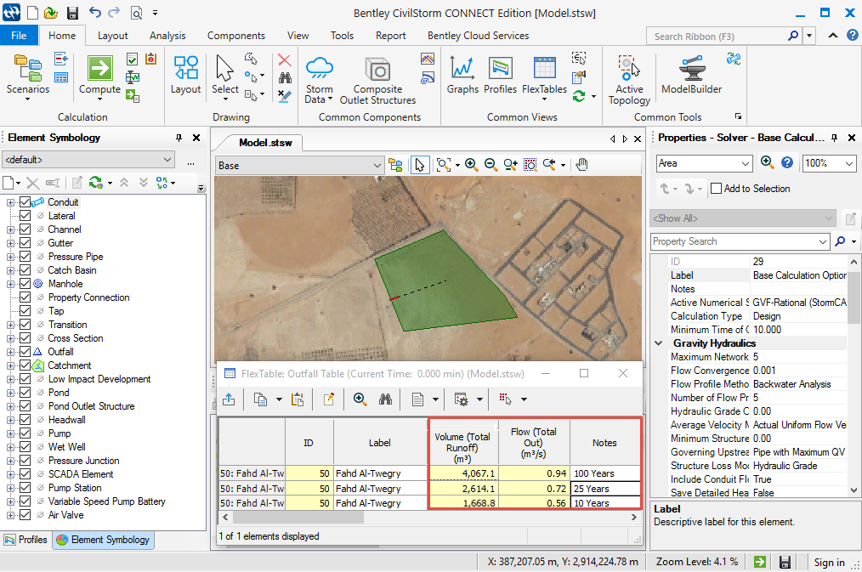
Alternative Solutions
Section Summary:
Recommendations for alternatives to the proposed solutions to protect the desired scheme from flood hazards and rainwater drainage;
Production of hydraulic models of the proposed solutions, using FlowMaster and Culvert Master Software;
Production of hydraulic modeling of the proposed storm drainage network designed using CivilStorm software;

Slide 26

TIME IS MONEY $$$
Let HOME | C&D get started improving your business NOW, so you see results TODAY!

